Slide 1
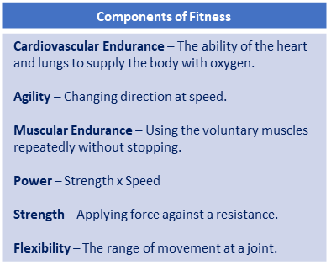
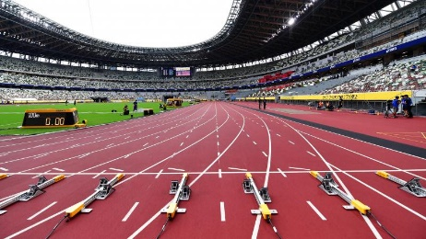
Year 7 Athletics (Skill Development): Journey of Knowledge
The bigger picture:
Personal development opportunities – Social skills including team work, organisation and planning.
Career links – PE teacher, physiotherapist, sports journalist, outdoor education instructor, coach, professional athlete, personal trainer.
RSE – ethics, compassion.
Context and Introduction to Unit: In this unit, pupils will perform various athletics events which focus on different components of physical fitness – 100/200m, relay, javelin, shot put and long jump. Pupils will learn the definitions of eight components of fitness and evaluate their own levels of fitness based on this knowledge. Pupils will investigate how the bones of the body are used to perform movement in partnership with the voluntary muscles. Pupils will make links between the effects of exercise on their physical, emotional and social wellbeing.
Prior knowledge (KS2): The Key Stage 2 PE curriculum states that all pupils will develop flexibility, strength, technique, control and balance as well as compare their performances to those completed previously and demonstrate improvement.
CORE KNOWLEDGE Physical Me Sprint/sprint start technique 100/200m (Marks/set/go phase, acceleration phase, drive phase, biomechanics of skill.) Relay changeover (Teams of 4, Palm up/palm down technique, start running when partner is 10m behind.) Javelin technique (OK grip, crucifix position, palm up, tip facing the sky, trajectory of throw.) Shot Putt technique (Clean palm/dirty fingers, rotate, extend the elbow on release.) Long jump technique (Run up, take off, landing, measurements.) Thinking Me ABC: Pupils are asked relevant questions about their lesson focus by the teacher (teaching points/tactics) and other pupils are asked to A, B or C their responses. Bones: The main bones of the body that are relevant to the movement in sporting activity such as athletics (See bones box in the vocabulary section). Necessary information to include: Whether the relevant bone is long/short/flat/irregular, as well as the main muscles that are attached to the bone. Healthy Me Physical health in order to meet the requirements of athletics – Coordination, cardiovascular endurance, agility, balance, speed, power, reaction time. Social Me This takes into account the behaviour/attitude of pupils as well as their ability to support each other and work together as a team. Also when explaining teaching points to each other to assist in each others development. Resilient Me - Doesn’t give up when skills are challenging and regroups and evaluates well when tactics are not working successfully | Core Skills A range of skills including: Track 100m sprint 200m sprint 800m Relay Field Javelin Shot put Long Jump Identify areas of strength and weakness in pupil’s own fitness through knowledge of components of fitness. Working as a collective unit when performing relay changeovers, pupils need to know which position each athlete will start in, when to run and which grip to use in order to pass the baton to the next person in the race. Determine the correct distance to jump from when taking off in jumping activities. How to break fall upon landing and how many steps required for the run up. Clean palm-dirty fingers for shot putt, spin movement for extra power Safety guidelines for throwing – safety zone and throwing zone, never go to retrieve javelin until teacher deems it safe to do so. Spring start technique – Find strongest foot for push off,. | ABOVE AND BEYOND Identify a method of training that could be used to develop each event. Identify meals/food-types that would be appropriate for various athletes. Effects of exercise on heart rate (BPM) VOCABULARY | Literacy in PE ‘ABC’ – Agree with/Build on/Contradict This is our literacy focus in PE which is a form of ‘academic talk’. Pupils are asked to state why they either agree with something their peers have said, state how they can build upon this point, or how can they contradict what their peer has said to challenge the thought process. This can be related to performance, form, skill selection etc. WHERE NEXT? - Identify various methods of training for each component of fitness and which ones would be applicable to selected sports (Football, netball, basketball etc.)
Word-rich Focus – Summer Term: Bones
Cranium Sternum Vertebrae | Femur Humerus Ribs

Slide 2
Year 7 Athletics: Assessment Plan
MAPs – Pupils will be assessed at the end of each topic via the Me in PE assessment model:
Physical Me: Skills and application of these into a competitive situation.
Thinking Me: ABC/Bones
Healthy Me: Physical attributes that are relevant to the activity.
Social Me: Behaviour, attitudes and support towards other pupils.
Resilient Me: Never giving up despite the challenge of the task that is presented to pupils.
Summative assessment (Me in PE) – The knowledge from this unit will be tested as part of a 1 hour P2S practical assessment at the end of the allocated half term focusing on Physical Me, Thinking Me, Healthy Me, Social Me and Resilient Me. The Me in PE assessment will be completed by the class teacher and distributed to pupils once the marks have been finalised so pupils can be informed which of the 5 areas they are performing well in and which areas they need to work further on.
Assessment Steps
Emerging | Developing | Securing | Mastering
Pupils display basic levels of athletic ability on a very inconsistent basis. Pupils articulation is very limited and requires a lot of support, physical health in relation to the activity is very limited, social skills are poor and resilience may be lacking: Able to run/jump/throw with very limited levels of coordination and agility. Lacks fluidity in movements. Articulation is very limited when explaining teaching points and how they are applied into a competitive situation. Very limited knowledge of bones in the body. Very limited speed, power, agility, reaction time and coordination. Social skills are very limited as well as communication between peers. Unwilling to persist with difficult challenges. | Pupils display developing levels of athletic ability on an inconsistent basis. Pupils articulation is fairly limited and requires some support, physical health in relation to the activity is average, social skills are developing and resilience is inconsistent: Able to run/jump/throw with limited levels of coordination and agility. Fluidity of movement is inconsistent. Articulation is limited when explaining teaching points and how they are applied into a competitive situation. Sometimes uses relevant terminology and tier 3 words. Limited knowledge of bones in the body. Limited speed, power, agility, reaction time and coordination. Social skills are inconsistent as well as communication between peers which can sometimes be limited. Gives up occasionally when faced with difficult challenges. | Pupils display consistently good levels of athletic ability. Pupils articulation is good, physical health in relation to the activity is well developed, social skills are developed displaying levels of confidence, and resilience is clear: Performs all runs/jumps/throws from the scheme of learning with coordination and agility. Fluidity of movement is consistent and results in times and distances that are consistent with national average. Articulation of performance is good. Pupils are able to link the relevant terminology and tier 3 words into sentences without much support from the teacher/peers. Good knowledge of the bones of the body. Secure levels of speed, power, agility, reaction time and coordination. Displays confidence in their social skills with good communication between their peers that often requires little to no support from the teacher. Rarely gives up when faced with a difficult challenge and persists with the task at hand. | Pupils display consistently high levels of athletic ability. Pupils articulation is clear, concise and developed, physical health in relation to the activity is elite, social skills are confident and supportive, and pupils enjoy difficult challenges: Performs all events from the scheme of learning with all relevant components of fitness. Fluidity of movement is consistent in results of times and distances that exceed national average. Articulation of performance is clear, concise and developed. Pupils are able to link the relevant terminology and tier 3 words into sentences unsupported. Excellent knowledge of the bones of the body. Elite levels of speed, power, agility, reaction time and coordination. Displays confidence in their social skills and can lead small groups during drills. Never gives up when faced with a difficult challenge and enjoys these circumstances.

