Slide 1
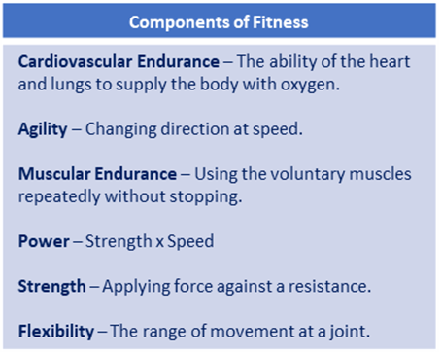
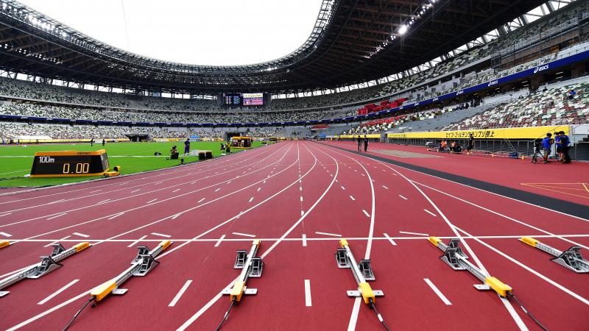
Year 8 Athletics (Tactics & Strategies): Journey of Knowledge
The bigger picture:
Personal development opportunities – Social skills including team work, organisation and planning.
Career links – PE teacher, physiotherapist, sports journalist, outdoor education instructor, coach, professional athlete, personal trainer
RSE – ethics, compassion.
Context and Introduction to Unit: In this unit, pupils will build on their knowledge of each athletics event practiced in Y7 by focusing on how they can apply tactics to them to outwit their opposition – 800m, 100m, high jump, triple jump, discus and javelin. Pupils will explain the organs and functions of the cardiovascular system and make links to how they are affected during athletic performance. Pupils will be introduced to a wide range of tactics and strategies such as when to speed up, slow down, overtake etc. In order to defeat an opponent using their mind and their own strengths.
Prior knowledge (Y7): Pupils have developed knowledge of the components of fitness in Y7 to highlight their own strengths and weaknesses. Pupils have developed a knowledge of the various track and field events as well as practiced a sprinting, relay, javelin and long jump.
CORE KNOWLEDGE Physical Me 800m (Pacing and Running technique) 100m (Sprint start, acceleration phase, drive phase, pacing) High Jump (Scissor kick/Fosbury flop) Triple Jump (Hop-step-jump) Discus (Handling/rotation/throw) Javelin (Crucifix/run up) Thinking Me Tactics & Strategies: Pupils knowing how to gain an advantage e.g. angle of throw, when to speed up, how many steps to take on a run up. ABC: Pupils are asked relevant questions about their lesson focus by the teacher (teaching points/tactics) and other pupils are asked to A, B or C their responses. CV System: Explain the organs/functions of the CV system in relation to athletics. Healthy Me Physical health in order to meet the requirements of athletics – Coordination, cardiovascular endurance, agility, balance, speed power, reaction time. Social Me This takes into account the behaviour/attitude of pupils as well as their ability to support each other and work together as a team. Also when explaining tactics to each other in order to outwit an opponent and set themselves up for a particular shot. Resilient Me Doesn’t give up when skills are challenging and regroups and evaluates well when tactics are not working successfully. | Core Skills A range of skills including: Track 100m sprint 800m Field Javelin Discus Triple jump High jump Identify areas of strength and weakness in pupil’s own fitness through knowledge of components of fitness. Tactics – Identify methods to outwit an opponent such as knowing when to enter inside lane for long distance run, which angle to throw in a field event, positions as a team in relay racing. Determine the correct distance to jump from when taking off in jumping activities. How to break fall upon landing and how many steps required for the run up. Hop/Step/Jump in triple jump. Scissor kick and Fosbury flop for high jump. Safety guidelines for throwing – safety zone and throwing zone, never go to retrieve javelin until teacher deems it safe to do so. Spring start technique – Find strongest foot for push off. | ABOVE AND BEYOND - Compare performances to national average data per event. - Identify a method of training that could be used to develop each event. - Identify meals/food-types that would be appropriate for various athletes. - Effects of exercise on heart rate (BPM) - Identify which events would be best suited to each of the somatotypes. VOCABULARY | Literacy in PE ‘ABC’ – Agree with/Build on/Contradict This is our literacy focus in PE which is a form of ‘academic talk’. Pupils are asked to state why they either agree with something their peers have said, state how they can build upon this point, or how can they contradict what their peer has said to challenge the thought process. This can be related to performance, form, skill selection etc. WHERE NEXT? - Analysis and feedback of performances in year 9.
Word-rich Focus – Summer Term: Cardiovascular System
Heart Oxygenated Blood Deoxygenated bllod Oxygen | Red blood cells Veins Arteries Capillaries

Slide 2
Year 8 Athletics: Assessment Plan
MAPs – Pupils will be assessed at the end of each topic via the Me in PE assessment model:
Physical Me: Skills and application of these into a competitive situation.
Thinking Me: ABC/CV System/Tactics & strategies
Healthy Me: Physical attributes that are relevant to the activity.
Social Me: Behaviour, attitudes and support towards other pupils.
Resilient Me: Never giving up despite the challenge of the task that is presented to pupils.
Summative assessment (Me in PE) – The knowledge from this unit will be tested as part of a 1 hour P2S practical assessment at the end of the allocated half term focusing on Physical Me, Thinking Me, Healthy Me, Social Me and Resilient Me. The Me in PE assessment will be completed by the class teacher and distributed to pupils once the marks have been finalised so pupils can be informed which of the 5 areas they are performing well in and which areas they need to work further on.
Assessment Steps
Emerging | Developing | Securing | Mastering
Pupils display basic levels of athletic ability and running/jumping/throwing is shown on a very inconsistent basis with little to no tactical awareness. Pupils articulation is very limited and requires a lot of support, physical health in relation to the activity is very limited, social skills are poor and resilience may be lacking: Able to perform run/jump/throw with very limited levels of coordination, reaction time, speed, power and agility. Tactical awareness is very limited (speeding up, take off for a jump, throwing technique etc.) Articulation is very limited when explaining teaching points and how they are applied into a competitive situation. Very limited knowledge of CV system. Very limited speed, power, agility, reaction time and coordination. Social skills are very limited as well as communication between peers. Unwilling to persist with difficult challenges. | Pupils display developing levels of athletic ability and running/jumping/throwing is shown on an inconsistent basis with some tactical awareness. Pupils articulation is fairly limited and requires some support, physical health in relation to the activity is average, social skills are developing and resilience is inconsistent: Able to perform run/jump/throw with limited levels of coordination, reaction time, speed, power and agility. Tactical awareness is limited (speeding up, take off for a jump, throwing technique etc.) Articulation is limited when explaining teaching points and how they are applied into a drill/game. Sometimes uses relevant terminology and tier 3 words. Limited knowledge of CV system. Limited speed, power, agility, reaction time and coordination. Social skills are inconsistent as well as communication between peers which can sometimes be limited. Gives up occasionally when faced with difficult challenges. | Pupils display consistent levels of athletic ability and good tactical awareness. Pupils articulation is good, physical health in relation to the activity is well developed, social skills are developed displaying levels of confidence, and resilience is clear: Performs all relevant athletic disciplines from the scheme of learning with accuracy, precision, coordination and agility. Tactical awareness is good (speeding up, take off for a jump, throwing technique etc.) Articulation of skills and performance is good. Pupils are able to link the relevant terminology and tier 3 words into sentences without much support from the teacher/peers. Good knowledge of CV system linking it to performance in athletics and the various events. Secure levels of speed, power, agility, reaction time and coordination. Displays confidence in their social skills with good communication between their peers that often requires little to no support from the teacher. Rarely gives up when faced with a difficult challenge and persists with the task at hand. | Pupils display consistently high levels of athletic ability in all events in the scheme of learning. A tactical approach is adopted during every performance. Pupils articulation is clear, concise and developed, physical health in relation to the activity is elite, social skills are confident and supportive, and pupils enjoy difficult challenges: Performs all relevant events from the scheme of learning, as well as advanced skills with accuracy, precision, coordination and agility. Tactical awareness is excellent (speeding up, take off for a jump, throwing technique etc.) Articulation of skills and performance is clear, concise and developed. Pupils are able to link the relevant terminology and tier 3 words into sentences unsupported. Excellent knowledge of the CV system and the effects athletics can have on this. Elite levels of speed, power, agility, reaction time and coordination. Displays confidence in their social skills and can lead small groups during drills. Never gives up when faced with a difficult challenge and enjoys these circumstances.

