Slide 1
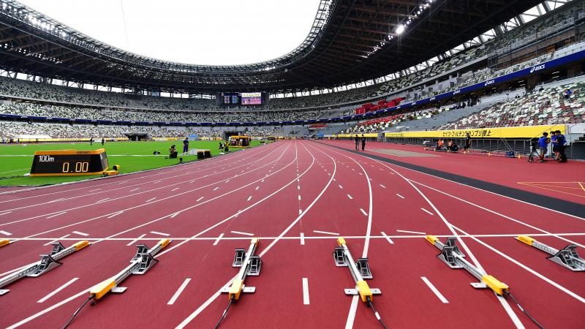
Year 9 Athletics (Analysis & Feedback): Journey of Knowledge
The bigger picture:
Personal development opportunities – Social skills including team work, organisation and planning.
Career links – PE teacher, physiotherapist, sports journalist, outdoor education instructor, coach, professional athlete, personal trainer
RSE – ethics, compassion.
Context and Introduction to Unit:
In this unit, pupils will build on their athletics technique & knowledge of the components of fitness in Y7 and tactical awareness in Y8 by analysing the athletic performance of themselves and their peers – 100m, relay, long jump, javelin, shot put & triple jump. Pupils will analyse normative data and make evaluations based on this compared with their own and their partners results. Pupils will make links between technique and results and identify ways to improve. Pupils will also gain a basic understanding of movement analysis, specifically in relation to planes of movement.
Prior knowledge (Y8): Pupils have developed knowledge of tactical awareness for athletics in Y8 which will provide them with ways in which to achieve targets based on national normative data against the listed events.
CORE KNOWLEDGE Physical Me Evaluate a your own/partners technique focusing on the components of fitness in Year 7 and tactical awareness from Year 8 in order to make progress. 100m analysis (Sprint start/Sprint technique). Relay analysis (Relay changeover, sprint technique). Long jump analysis (Run up, take-off, landing). Javelin analysis (Stance, crucifix, release, run up). Shot put analysis (Shuffle, grip, push). Triple Jump analysis (Run up, hop/step/jump, landing). Thinking Me Analysis & Feedback: Pupils being able to analyse their own/peers performances against the professional model and feedback in a supportive and constructive manner. ABC: Pupils are asked relevant questions about their lesson focus by the teacher (teaching points/tactics) and other pupils are asked to A, B or C their responses. Long-term effects of exercise: Hypertrophy, cardiac output, heart rate, stroke volume and vital capacity. Healthy Me Physical health in order to meet the requirements of athletics – Coordination, cardiovascular endurance, agility, balance, speed power, reaction time. Social Me This takes into account the behaviour/attitude of pupils as well as their ability to support each other and work together as a team. Also when analysing skills/tactics to each other in order to outperform another opponent in any athletic discipline. Resilient Me Doesn’t give up when skills are challenging and regroups and evaluates well when analysis is not as effective as it could be. | CORE SKILLS A range of skills including: Track 100m sprint (Speed, power & reaction time) Relay (Speed, coordination & communication) Field Javelin (Coordination & power) Discus (Coordination, power & strength) Triple jump (Power, coordination & speed) Long Jump (Speed & power) Analysis & Feedback Analyse and interpret data: Normative data in comparison to personal data. Self-assessment and peer assessment linked to athletic performance and provide detailed feedback on how to improve. Identify strengths and weaknesses in your own performance as well as others. Articulate knowledge of technique using oracy in order for your partner to understand and make progress. Ability to analyse and safely judge the safety procedures in place for you and your partner when setting up and event – particularly throwing events which needs a safety zone and a throwing zone to ensure that no body gets hurt. | ABOVE AND BEYOND Describe short & long term effects of exercise on the body systems (Cardiovascular & muscular.) Axes of rotation in relation to athletic performance. VOCABULARY | Literacy in PE ‘ABC’ – Agree with/Build on/Contradict This is our literacy focus in PE which is a form of ‘academic talk’. Pupils are asked to state why they either agree with something their peers have said, state how they can build upon this point, or how can they contradict what their peer has said to challenge the thought process. This can be related to performance, form, skill selection etc. WHERE NEXT? - Cambridge Nationals: Sport Studies (Level 2).
Components of Fitness
Agility – How quickly you can change direction. Coordination – The ability to use more than one body part at the same time. Speed – The time taken to cover a distance. Power – Using speed quickly (Strength x speed). Reaction Time – The time it takes to respond to a stimulus.
Word-rich Focus: Summer Term 1 & 2 Long-term Effects of Exercise
Hypertrophy – An increase in size and strength of muscle tissue from exercise. Cardiac Output – Amount of blood pumped out the heart in one minute increases. | Heart rate – The amount of blood that leaves the heart in one beat decreases. Stroke volume – The amount of blood that pumps out the heart with every beat increases.

Slide 2
Year 9 Athletics: Assessment Plan
MAPs – Pupils will be assessed at the end of each topic via the Me in PE assessment model:
Physical Me: Skills and application of these into a competitive situation.
Thinking Me: ABC/Long-term effects of exercise on the cardio-respiratory system.
Healthy Me: Physical attributes that are relevant to the activity.
Social Me: Behaviour, attitudes and support towards other pupils.
Resilient Me: Never giving up despite the challenge of the task that is presented to pupils.
Summative assessment (Me in PE) – The knowledge from this unit will be tested as part of a 1 hour P2S practical assessment at the end of the allocated half term focusing on Physical Me, Thinking Me, Healthy Me, Social Me and Resilient Me. The Me in PE assessment will be completed by the class teacher and distributed to pupils once the marks have been finalised so pupils can be informed which of the 5 areas they are performing well in and which areas they need to work further on.
Assessment Steps
Emerging | Developing | Securing | Mastering | Excelling
Pupils display basic levels of athletic ability and adequate run/jump/throw technique is shown on a very inconsistent basis with little to no tactical awareness. Pupils articulation of analysis and feedback is very limited and requires a lot of support, physical health in relation to the activity is very limited, social skills are poor and resilience may be lacking: Able to perform run/jump/throw technique with very limited levels of coordination, speed, balance, power, reaction time, strength and agility. Tactical awareness is very limited (Speeding up, angle of release from a throw, stride length for a jump etc.) Lacks fluidity in their movement. Articulation is very limited when explaining teaching points and how they are applied into a performance. Analysis is limited and needs constant support when observing a peer. Feedback requires structure and prompting. Very limited knowledge of long-term effects of exercise on the C-R system. Very limited speed, power, agility, reaction time and coordination. Social skills are very limited as well as communication between peers. Unwilling to persist with difficult challenges. | Pupils display developing levels of athletics ability run/jump/throw technique is shown on an inconsistent basis with some tactical awareness. Pupils articulation of analysis and feedback is fairly limited and requires some support, physical health in relation to the activity is average, social skills are developing and resilience is inconsistent: Able to perform run/jump/throw technique with limited levels of coordination and agility. Tactical awareness is limited (Speeding up, angle of release from a throw, stride length for a jump etc.) Fluidity in their movement is inconsistent. Articulation is limited when explaining teaching points and how they are applied into a drill/game. Sometimes uses relevant terminology and tier 3 words. Analysis is fairly limited and needs a little support when observing a peer. Feedback requires prompting. Limited knowledge of long-term effects of exercise on the C-R system. Limited speed, power, agility, reaction time and coordination. Social skills are inconsistent as well as communication between peers which can sometimes be limited. Gives up occasionally when faced with difficult challenges. | Pupils display adequate athletic ability which is fairly clear to see as well as good tactical awareness. Pupils articulation of analysis and feedback is good, physical health in relation to the activity is well developed, social skills are developed displaying levels of confidence, and resilience is clear: Performs all relevant events from the scheme of learning with accuracy, precision, coordination and agility. Tactical awareness is good (Speeding up, angle of release from a throw, stride length for a jump etc.) Fluidity in movement is consistent in most events. Articulation of skills and performance is good. Pupils are able to link the relevant terminology and tier 3 words into sentences without much support from the teacher/peers. Analysis of performance is good and require support occasionally when observing a peer. Feedback is fairly detailed and informative. Good knowledge of the long-term effects of exercise linking it to performance in athletics. Secure levels of speed, power, agility, reaction time and coordination. Displays confidence in their social skills with good communication between their peers that often requires little to no support from the teacher. Rarely gives up when faced with a difficult challenge and persists with the task at hand. | Pupils display consistent effective athletic ability at all times. A tactical approach is adopted during every event. Pupils articulation of analysis and feedback is clear, concise and developed, physical health in relation to the activity is elite, social skills are confident and supportive, and pupils enjoy difficult challenges: Performs all relevant events from the scheme of learning, as well as advanced skills with accuracy, precision, coordination and agility. Tactical awareness is excellent (Speeding up, angle of release from a throw, stride length for a jump etc.) Fluidity in movement is clear in all events. Articulation of skills and performance is clear, concise and developed. Pupils are able to link the relevant terminology and tier 3 words into sentences. Analysis of performance is excellent and is done independently. Feedback is constructive and structured. Excellent knowledge of the long-term effects of exercise and the effects athletics can have on this. Elite levels of speed, power, agility, reaction time and coordination. Displays confidence in their social skills and can lead small groups during drills. Never gives up when faced with a difficult challenge and enjoys these circumstances. | Pupils display elite-level performance/technique in athletics at all times. A tactical approach is coached to peers. Pupils articulation of analysis and feedback is constructive, physical health in relation to the activity is elite, social skills are confident and supportive, and pupils focus on difficult challenges: Performs all relevant shots from the scheme of learning, as well as advanced skills with accuracy, precision, coordination and agility. Tactical awareness is excellent (Speeding up, angle of release from a throw, stride length for a jump etc.) Fluidity in movement is clear and smooth in all events. Articulation of skills and performance is clear, concise and developed. Pupils are able to link the relevant terminology and tier 3 words into sentences and coach Analysis of performance is excellent and is done independently. Feedback is constructive and structured as well as supportive. Excellent knowledge of the long-term effects of exercise and the effects tennis can have on this. Elite levels of speed, power, agility, reaction time and coordination. Displays confidence in their social skills and can lead small groups during drills. Never gives up when faced with a difficult challenge and enjoys these circumstances.

