Slide 1

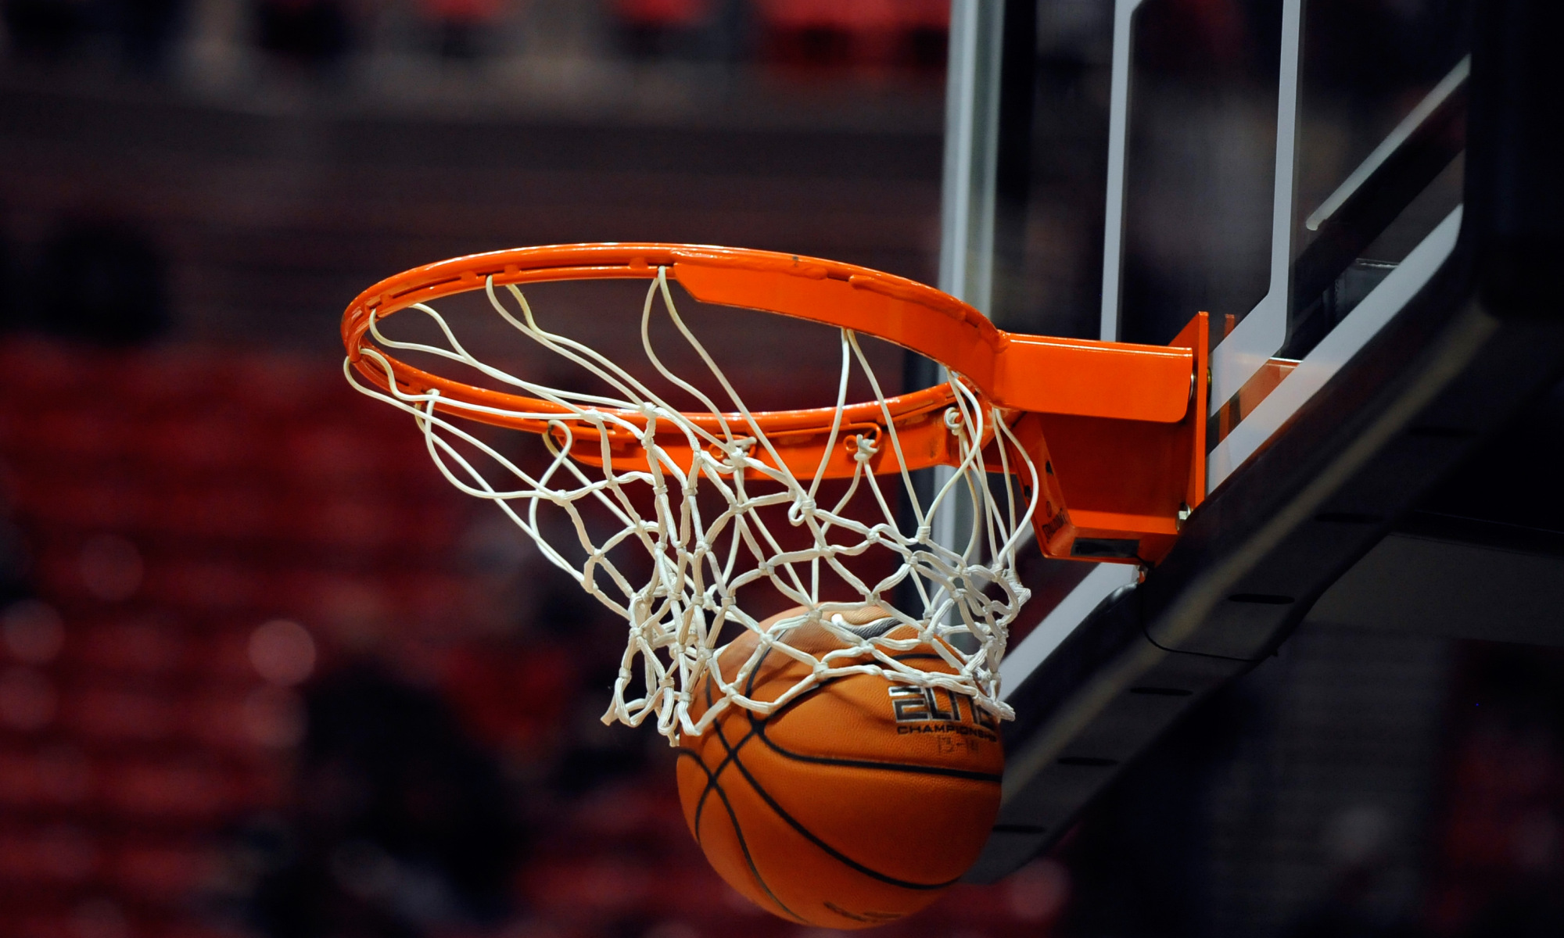
Y7 Basketball (Skills Development): Journey of Knowledge
The bigger picture:
Personal development opportunities – Social skills including team work, organisation and planning.
Career links – PE teacher, physiotherapist, sports journalist, outdoor education instructor, coach, professional athlete, personal trainer
RSE – ethics, compassion.
Context and Introduction to Unit
In this unit pupils will learn about the skills and abilities required to perform in basketball effectively. They will learn about the rules of game play and be able to apply and link them to competitive situations demonstrating both control and accuracy. Pupils will learn specific skills including, passing, dribbling, shooting, footwork, movement and also officiating. They will learn to use these skills to outwit opponents in challenging game based environments and will be able to link skills from previous units and similar sports. Pupils will also learn the relevant components of fitness for basketball and develop their oracy skills by applying these words into sentences.
Prior knowledge (KS2/KS3)
Pupils should be able to play competitive games, modified where appropriate and apply basic principles suitable for attacking and defending. This includes basic throwing and catching principles and awareness of space and movement. They may also have prior knowledge of basic rules for basketball.
CORE KNOWLEDGE Physical Me’ Passing – elbows wide, grip ball with fingers spread using 2 hands, step forward with pass, eyes on the target (wait for a signal), flick the wrists down when releasing the ball. Catching – catch with 2 hands, fingers spread across the ball, watch the ball into your hands, trap the ball with your hands. Dribbling – push the ball towards the floor in front of you, the ball should return to waist height. Shooting – ensure body is balanced, feet shoulder apart, ball rests in palm of shooting hand, alternate hand supports ball. Bend knees and straighten as release the ball. Ensure you look at the target. ‘Thinking Me’ ABC: Pupils are asked relevant questions about their lesson focus by the teacher (teaching points/tactics) and other pupils are asked to A, B or C their responses. Word Rich Focus – Components of fitness : The fitness components related to different sports and movements and how these can be defined. Basketball rules Footwork (2 steps allowed with the ball), dribble with single hand only, once you stop with the ball you must pass or shoot (no further dribble allowed), no contact with opposition allowed. ‘Healthy Me’ Pupils should demonstrate the appropriate levels of fitness for basketball as well as mental resilience to persist with the development of weaknesses. Pupils should recognize the wider health benefits of participation in basketball (Nutrition, positive body image, stress relief, preventing loneliness, new friendship, positive mindset). Social Me This takes into account the behavior/attitude of pupils as well as their ability to support each other and work together as a team. Also when explaining tactics to each other in order to outwit an opponent and set themselves up for a particular skill. Resilient Me Doesn’t give up when skills are challenging and regroups and evaluates well when skills are not working successfully. | CORE SKILLS Demonstrate warm up routines for basketball (pulse raising activity such as jogging, stretching muscles: hamstrings, quadriceps, gastrocnemius, triceps, biceps) Demonstration and application of the following skills; Dribbling Passing Catching Shooting Identify areas of strength and weakness in a peers performance (Assessment) Articulate knowledge of skills technique orally Health/Fitness Know why we warm up - to prevent injury, mobilise joints, raise body temperature Identify the relevant muscles required for basketball such as deltoids, quadriceps, hamstrings, gastrocnemius, biceps, triceps and the abdomen. Define key fitness components in relation to basketball (coordination, agility, power) Communicate with others on their team to work out strategies to score and pass the ball from one end of the court to the other without the ball being intercepted by the opposing team. | ABOVE AND BEYOND Leadership of others (captain, coach, manager) Extra curricular involvement (school or community) Explain the basic tactics required for a full size basketball game VOCABULARY | Literacy in PE ‘ABC’ – Agree with/Build on/Contradict This is our literacy focus in PE which is a form of ‘academic talk’. Pupils are asked to state why they either agree with something their peers have said, state how they can build upon this point, or how can they contradict what their peer has said to challenge the thought process. This can be related to performance, form, skill selection etc. WHERE NEXT? Tactics and strategies for basketball (Y8)
Word-rich Focus – Autumn Term: Components of Fitness
Coordination – The ability to use more than one body part at the same time. Agility – The ability to change direction at speed. Speed – The time it takes to cover a distance. Balance – Maintaining the centre of mass over the base of support. Coordination – The ability to use more than one body part at the same time. Power – Using strength quickly (Strength x Speed). | Flexibility – The amount of movement possible at a joint. Cardiovascular Endurance – The ability of the heart and lungs to work together to supply the body with oxygen. Strength – The amount of force against a resistance. Muscular Endurance – Using the muscles repeatedly without getting tired. Reaction Time – The ability to respond to a stimulus.

Slide 2
Year 7 Basketball: Assessment Plan
MAPs – Pupils will be assessed at the end of each topic via the Me in PE assessment model:
Physical Me: Skills and application of these into a competitive situation.
Thinking Me: ABC/Components of Fitness
Healthy Me: Physical attributes that are relevant to the activity.
Social Me: Behaviour, attitudes and support towards other pupils.
Resilient Me: Never giving up despite the challenge of the task that is presented to pupils.
Summative assessment (Me in PE) – The knowledge from this unit will be tested as part of a 1 hour P2S practical assessment at the end of the allocated half term focusing on Physical Me, Thinking Me and Healthy Me. The Me in PE assessment will be completed by the class teacher and distributed to pupils once the marks have been finalised so pupils can be informed which of the 5 areas they are performing well in and which areas they need to work further on.
Assessment Steps
Emerging | Developing | Securing | Mastering
Pupils have basic knowledge of game rules as well how to perform passing, ball control, dribbling and shooting skills, as well as the ability to referee effectively; they require help from their teacher: Demonstrates some ball control in isolation and under pressure but lacks accuracy and fluency in technique. Demonstrates some passing in isolation and under pressure but lacks accuracy and fluency in technique. Demonstrates some dribbling in isolation and under pressure but lacks accuracy and speed. Demonstrates some shooting in isolation and under pressure but lacks accuracy and consistency. Demonstrates some awareness of formation and position on court but is unable to sustain a role. Has a limited knowledge of refereeing using support from the teacher to enforce the rules. Can keep score. Demonstrates limited awareness of basketball rules (e.g. fouls, ball out of play) and decision making is often inaccurate (i.e. Gives the ball away through a wrong pass or dribble). Can state some components of fitness. Fitness is limited for basketball and is unable to sustain it for the duration of the activity (i.e. lacks coordination, agility, power and speed). Communication requires a lot of support from peers and teacher. Resilience is rare. | Pupils must have a basic knowledge of game rules as well how to perform passing, control, dribbling and shooting skills, although performance can be inconsistent. They can referee effectively but require help from their teacher: Demonstrates ball control in isolation and under pressure with some accuracy and fluency in technique. Demonstrates passing in isolation and under pressure with some accuracy and consistency in technique. Demonstrates dribbling in isolation and under pressure with accuracy and moderate speed. Demonstrates shooting in isolation and under pressure with some accuracy and consistency. Demonstrate some more advanced skills (pivoting, cross over dribble, lay up, marking, use of weaker hand) but these are not consistent. Demonstrates good awareness of different formation and position on court but is inconsistent in sustaining a role. Has a good knowledge of refereeing using some support from the teacher to enforce the rules. Can keep score and use some signals. Demonstrates good awareness of basketball rules (e.g. fouls, ball out of play, timing regulations) and decision making is often accurate. Can state and describe some components of fitness. Fitness is good for Basketball and is able to sustain it for the duration of the activity (i.e. coordination, agility, speed, power and balance). Communication requires some support from peers and teacher. Occasionally demonstrates resilience. | Pupils must be able to perform the following skills/actions with consistently good technique: Demonstrates ball control in isolation and under pressure with accuracy and fluency in technique using both feet. Demonstrates passing in isolation and under pressure with accuracy and consistency in technique with both hands. Demonstrates dribbling in isolation and under pressure with accuracy, precision and varying speed. This is performed using both hands. Demonstrates shooting in isolation and under pressure with accuracy and power from static or from a dribble and with both hands. Demonstrate more advanced skills (pivoting, cross over dribble, lay up, marking, use of weaker hand) with good technique and consistency. Demonstrates very good awareness of different formation and position on court and can explain when you might use these systems. Can sustain a given role in the game. Has a very good knowledge of refereeing without support from the teacher to enforce the rules confidently. Can keep score and use signals whilst also explaining decisions made. Demonstrates very good awareness of basketball rules (e.g. fouls, ball out of play, timing regulations) and decision making is mostly accurate. Can explain some components of fitness in relation to basketball. Fitness is very good for Basketball and is able to sustain it for the duration of the activity (i.e. coordination, agility, speed, power and balance). Communication is effective in games. Regularly demonstrates resilience. | Pupils should be able to recall and demonstrate all the content in the knowledge journey and demonstrate application through the following: Confidently demonstrates ball control in isolation and under pressure with accuracy and fluency in technique using both hands. Confidently demonstrates passing in isolation and under pressure with accuracy and consistency in technique with both hands and in close and longer range with disguise. Confidently demonstrates dribbling in isolation and under pressure with accuracy, precision and varying speed. This is performed using both hands and using disguise within movements. Confidently demonstrates shooting in isolation and under pressure with accuracy and consistency from static or from the dribble and with both hands. Can aim shots from varying angles and distances with precision. Confidently demonstrate more advanced skills (pivoting, cross over dribble, lay up, marking, use of weaker hand) with excellent technique, precision and consistency. Demonstrates excellent awareness of different formation and position and can explain when you might use these systems. Can sustain a given role in the game and lead others. Has excellent knowledge of refereeing without support from the teacher to enforce the rules confidently. Can keep score and use signals whilst also explaining decisions made with confidence. Demonstrates excellent awareness of basketball rules and decision making is almost always accurate. Can explain all components of fitness in relation to basketball. Fitness is excellent for Basketball and is able to sustain it for the duration of the activity at high levels of intensity. Communication is effective and dominant in games. Always demonstrates resilience.

