Slide 1

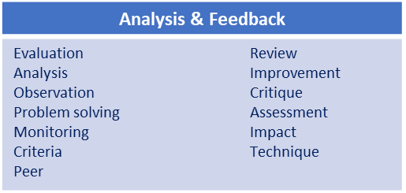
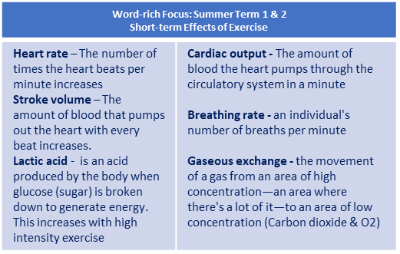
Y9 Handball (Evaluation and Analysis): Journey of Knowledge
The bigger picture:
Personal development opportunities – Social skills including team work, organisation and planning.
Career links – PE teacher, physiotherapist, sports journalist, outdoor education instructor, coach, professional athlete, personal trainer
RSE – ethics, compassion.
Context and Introduction to Unit
In this unit pupils will learn about the evaluation and analysis of performance in handball. They will learn how to observe other’s performance and highlight strengths and areas for improvement. They will also learn how to communicate their opinions effectively and sensitively. They will link the previous techniques learnt to their observations and be able to skilfully suggest ways in which improvement can be made; equally they will learn to evaluate the impact this has.
Prior knowledge (KS2/KS3)
In Y8 pupils will have learnt a range of tactics and strategies required to outwit opponents effectively in handball. The will have knowledge of the game rules and a range of skills including passing dribbling and shooting. They will also be able to plan tactics/strategies for success and also demonstrate disguise, placement and adaptability to game play.
CORE KNOWLEDGE ‘Physical Me Passing – elbow high (above head), grip ball with fingers spread using 1 hand, opposite foot forward when throwing, eyes on the target (wait for a signal), flick the wrist when releasing the ball Catching – catch with 2 hands, fingers spread across the ball, watch the ball into your hands, trap the ball with your hands Dribbling – 1 bounce to 3 steps (try to discourage repeated bouncing like in basketball), push the ball towards the floor in front of you, the ball should return to waist height Shooting - elbow high (above head), opposite foot forward when throwing, take aim (to a corner ideally), use the steps and a jump prior to the shot release ‘Thinking Me’ Analysis & Feedback: Pupils being able to analyse their own/peers performances against the professional model and feedback in a supportive and constructive manner. ABC: Pupils are asked relevant questions about their lesson focus by the teacher (teaching points/tactics) and other pupils are asked to A, B or C their responses. Short-term effects of exercise: cardiac output, heart rate, stroke volume, breathing rate and gaseous exchange. ‘Healthy Me’ Pupils should demonstrate the appropriate levels of fitness for handball as well as mental resilience to persist with the development of weaknesses whilst working alongside others as a performer or a coach. Pupils should recognize the wider health benefits of participation in handball (Nutrition, positive body image, stress relief, preventing loneliness, new friendship, positive mindset). Social Me This takes into account the behaviour/attitude of pupils as well as their ability to support each other and work together as a team. Also when analysing skills/tactics to each other in order to outperform another opponent in any athletic discipline. Resilient Me Doesn’t give up when skills are challenging and regroups and evaluates well when analysis is not as effective as it could be. | CORE SKILLS Lead others in warm up routines for handball (pulse raising activity such as jogging, stretching muscles: hamstrings, quadriceps, gastrocnemius, triceps, biceps, deltoid, trapezius) Demonstration and application of the following skills; Observation Assessment Recording accurately Measurement Review Communication Acting on advice from others Justify areas of strength and weakness in own performance (Listen to peers assessment and watch back any video footage to develop technique when cross referencing this with elite models). Articulate knowledge of tactics and strategies orally to others as well as coach a partner/team upon analysis of live play. | ABOVE AND BEYOND Coach others to improve their performance Model correct technique (demonstration/explanation) VOCABULARY | Literacy in PE ‘ABC’ – Agree with/Build on/Contradict This is our literacy focus in PE which is a form of ‘academic talk’. Pupils are asked to state why they either agree with something their peers have said, state how they can build upon this point, or how can they contradict what their peer has said to challenge the thought process. This can be related to performance, form, skill selection etc. WHERE NEXT? Pupils demonstrate these skills in the ‘developing sports skills’ unit of Cambridge National: Sport Studies (Level 2)

Slide 2
Year 9 Handball: Assessment Plan
MAPs – Pupils will be assessed at the end of each topic via the Me in PE assessment model:
Physical Me: Skills and application of these into a competitive situation.
Thinking Me: ABC/Short-term effects of exercise on the cardio-respiratory system.
Healthy Me: Physical attributes that are relevant to the activity.
Social Me: Behaviour, attitudes and support towards other pupils.
Resilient Me: Never giving up despite the challenge of the task that is presented to pupils.
Summative assessment (Me in PE) – The knowledge from this unit will be tested as part of a 1 hour P2S practical assessment at the end of the allocated half term focusing on Physical Me, Thinking Me, Healthy Me, Social Me and Resilient Me. The Me in PE assessment will be completed by the class teacher and distributed to pupils once the marks have been finalised so pupils can be informed which of the 5 areas they are performing well in and which areas they need to work further on.
Assessment Steps
Emerging | Developing | Securing | Mastering | Excelling (Above and Beyond)
Pupils can demonstrate basic technique of passing, dribbling and shooting skills. Analysis and feedback is limited and requires guidance from the teacher. Requires leadership from teacher/peers in identifying each stage of the relevant skill. Requires assistance when identifying weaknesses and communicating this to peers. Can play a small sided game but does not apply tactical elements to game play. Has a limited knowledge of refereeing using support from the teacher to enforce the rules. Can keep score. Can define a few short term effects of exercise accurately Cannot identify short term effects of exercise Fitness is limited for basketball and is unable to sustain it for the duration of the activity (i.e. lacks coordination, agility, power and speed). Social skills are very limited as well as communication between peers. Unwilling to persist with difficult challenges. | Pupils can demonstrate fair technique of passing, dribbling and shooting skills. Analysis and feedback is limited but requires some guidance from the teacher. Can identify most strengths in performance but requires assistance when identifying weaknesses. Can provide feedback to peers unassisted but struggles to identify ways forward. Can play a small sided game and applies some tactical elements to game play. Has a good knowledge of refereeing using some support from the teacher to enforce the rules. Can keep score and use some signals. Can define a few short term effects of exercise accurately and relate to how they affect the body. Can identify some short term effects of exercise Fitness is good for basketball and is able to sustain it for the duration of the activity (i.e. coordination, agility, speed, power and balance). Social skills are inconsistent as well as communication between peers which can sometimes be limited. Gives up occasionally when faced with difficult challenges. | Pupils must be able to perform all skills within the unit with consistently good technique and analysis and feedback is clear and precise. Can identify most strengths and weaknesses in performance whilst describing ways to improve. Can provide feedback to peers unassisted with at least two clear points made. Can play a small sided game and applies tactical elements to game play which are effective. Has a very good knowledge of refereeing without support from the teacher to enforce the rules confidently. Can keep score and use signals whilst also explaining decisions made. Can identify and define a range of short term effects of exercise accurately and relate to how they affect the body. Can identify short term effects of exercise and knows how they all inter relate Fitness is very good for basketball and is able to sustain it for the duration of the activity (i.e. coordination, agility, speed, power and balance). Displays confidence in their social skills with good communication between their peers that often requires little to no support from the teacher. Rarely gives up when faced with a difficult challenge and persists with the task at hand. | Pupils should be able to recall all the content in the knowledge journey and demonstrate clear and precise feedback through peer and self analysis. Can identify all strengths and weaknesses in their own performance and others. Can provide clear and coherent feedback on their own performance and a partners by identifying clear ways forward and modelling correct technique. Can play a small sided game and applies tactical elements to game play which have a dominant impact on the game. Has excellent knowledge of refereeing without support from the teacher to enforce the rules confidently. Can keep score and use signals whilst also explaining decisions made with confidence. Can identify and define a wide range of short term effects of exercise accurately and relate to how they affect the body in relation to differing sports/intensity. Can identify all the short term effects of exercise and has a deep understanding of how they inter relate Fitness is excellent for basketball and is able to sustain it for the duration of the activity at high levels of intensity (i.e. coordination, agility, speed, power and balance). Displays confidence in their social skills and can lead small groups during drills. Never gives up when faced with a difficult challenge and enjoys these circumstances. | Pupils should be able to recall all the content in the knowledge journey and demonstrate excellent feedback through peer and self analysis. Can identify all strengths and weaknesses in their own performance and others, including game play and refereeing. Can provide clear and coherent feedback on their own performance and a partners by identifying clear ways forward and modelling correct technique, including refereeing. Has excellent knowledge of refereeing without support from the teacher to enforce the rules confidently. Can keep score and use signals whilst also explaining decisions made with confidence. Can identify and define all short term effects of exercise accurately and relate to sporting movements and differing intensities. Can also relate these to longer term effects. Can identify all the short term effects of exercise and a wide range of long term effects too. This is considered in their exercise in order to maximize personal performance. Fitness is excellent for basketball and is able to sustain it for the duration of the activity at high levels of intensity (i.e. coordination, agility, speed, power and balance). Displays confidence in their social skills and can lead small groups during drills. Never gives up when faced with a difficult challenge and enjoys these circumstances.

