Slide 1

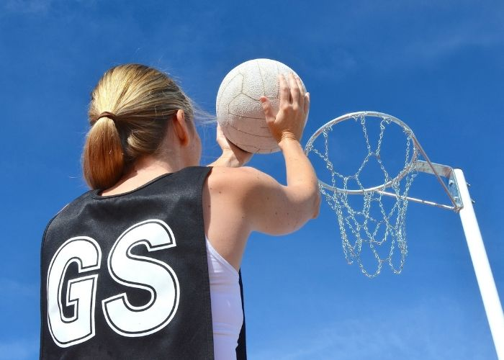
Y7 Netball (Skill Development): Journey of Knowledge
The bigger picture:
Outside links to netball clubs.
Career links – Coach / PE teacher
RSE – Understanding of nutrition and emotional benefits of exercise
Context and Introduction to Unit
In this unit pupils will learn about the skills and knowledge required to perform in netball effectively. They will learn about the rules of the game and how to apply them to competitive situations demonstrating both control and accuracy. Pupils will learn specific skills including passing, dribbling, shooting, footwork, and also how to officiate in a game. Pupils will then be able to link the components of fitness to different aspects of netball.
Prior knowledge (KS2/KS3)
Pupils should have been taught a range of basic skills at KS2 based around a variety of different games based activities. The Key Stage 2 PE Curriculum states that all pupils will develop flexibility, strength, technique, control and balance as well as compare their performances to those completed previously and demonstrate improvement.
CORE KNOWLEDGE (Me in PE) ‘Physical Me’ Passing – four main passes : chest, bounce, shoulder and overhead Chest Pass: elbows out, fingers spread around ball, step into the pass and extend arms Bounce Pass: bounce ¾ of the way to person bouncing to, 2 hands on ball Shoulder Pass: one hand, bend the arm to the shoulder then extend up high Overhead: Two hands on ball, bend arms behind head then extend above head Footwork – Landing foot is also a pivot foot, can land left, right or right, left or two feet Dodging – Three types: Sprint, Feint, Reverse Marking – marking the player with the ball – 1m away arms up and also marking a player – in front looking over shoulder, shadowing them using to try and intercept the ball ‘Thinking Me’ The court markings, divided into thirds. How to umpire, how the components of fitness are linked to netball: coordination, agility, balance, power. Pupils should be able to support the progress of themselves and peers through the evaluation of strengths and weaknesses with the support of skill cards and teacher instruction. Netball Rules Ball held for maximum of 3 seconds (free pass awarded if not) Obstruction – must be 1m away from player with the ball (penalty pass if not) Contact – no pushing, elbows, touching (penalty pass if contact made) Out of court: throw in from behind the line Shooting – must go through the hoop and can only score from the semi-circle ‘Healthy Me’ Pupils should demonstrate the appropriate levels of fitness for football as well as mental resilience to persist with the development of weaknesses. Pupils should recognize the wider health benefits of participation in football (Nutrition, positive body image, stress relief, preventing loneliness, new friendship, positive mindset). | Core Skills Demonstrate warm up routines for netball (pulse raising activity such as jogging, stretching muscles: hamstrings, quadriceps, gastrocnemius, triceps, biceps) Demonstration and application of the following skills; Passing Footwork Dodging Marking Identify areas of strength and weakness in a peers performance (Assessment) Articulate knowledge of skills technique orally Health / Fitness Know why we warm up - to prevent injury, mobilise joints, raise body temperature. How is oxygen transported around the body? Define key fitness components in relation to netball (agility, speed, balance, power)) | ABOVE AND BEYOND - Leadership of others (captain, coach, manager). - Extra curricular involvement (school or community). VOCABULARY Coordination – the use of two or more body parts at the same time. Agility – changing direction at speed. Speed – amount of time taken to cover a set distance. Balance – keeping the centre of mass above the base of support. Power – performing strength activities at speed. | Literacy in PE ‘ABC’ – Agree with/Build on/Contradict This is our literacy focus in PE which is a form of ‘academic talk’. Pupils are asked to state why they either agree with something their peers have said, state how they can build upon this point, or how can they contradict what their peer has said to challenge the thought process. This can be related to performance, form, skill selection etc. WHERE NEXT? This knowledge should give pupils the foundation to go on and now develop tactics and strategies within year 8.
Anatomy & Physiology
Quadriceps Gastrocnemius Triceps Biceps Hamstrings | Heart Lungs Arteries Veins Oxygen

Slide 2
Year 7 Netball (Skill Development): Assessment Plan
MAPs – Pupils will complete one MAP mid way through this unit. Pupils will be assessed via:
1. Their practical ability demonstrated during the MAP lesson (Passing / footwork / marking technique depending on where they are up to in the scheme.)
2. Their ability to link the relevant components of fitness to the activity they are being assessed in.
3. Their ability to demonstrate their current levels of fitness, mental perseverance and social wellbeing by working collaboratively as a team.
Summative assessment (Me in PE) – The knowledge from this unit will be tested as part of a 1 hour P2S practical assessment at the end of the allocated half term focusing on Physical Me, Thinking Me and Healthy Me. Video evidence will be collected and the Me in PE assessment form will be completed by the class teacher.
Assessment Steps
Emerging | Developing | Securing (up to ‘+’) | Mastering (Above & Beyond)
Pupils have basic knowledge of game rules as well as how to perform passing, footwork, dodging and marking skills, as well as the ability to umpire effectively with help from the teacher. Demonstrates some of the main passes in netball in isolation but lacks power and accuracy Demonstrates some of the footwork rule in isolation but lacks balance and accuracy with the ball Demonstrates some of the dodging techniques in isolation but lacks drive and speed Demonstrates some level of marking in isolation but lacks effective technique when under pressure Demonstrates some awareness of the different positions and areas of play in netball but is unable to sustain a role. Has a limited knowledge of umpiring using support from the teacher to enforce the rules. Can keep score Demonstrates limited awareness of netball rules (e.g. obstruction, ball out of court) and decision making is often inaccurate Fitness is limited for Netball and is unable to sustain it for the duration of the activity (i.e. lacks coordination, agility, power and speed | Pupils must have a basic knowledge of game rules as well how to perform passing, footwork, dodging and marking skills. Performance can be inconsistent and they can referee effectively but may require help from their teacher. Demonstrates a range of passes in netball in isolation with some power and accuracy Demonstrates the footwork rule in isolation with balance and accuracy and also with the ball under pressure Demonstrates a range of dodging techniques in isolation and under pressure with drive and speed and Demonstrates the correct technique for marking in isolation and does have some effect when under pressure. Demonstrates good awareness of the different positions and areas of play in netball and is able to take on a positional role but will lack consistency in play Has a good knowledge of umpiring using support from the teacher to enforce the rules. Can keep score and award free passes and out of court throw ins. Demonstrates good awareness of netball rules (e.g. obstruction, ball out of court, contact) and decision making is often accurate Fitness is good for Netball and is able to sustain it for the duration of the activity (i.e. coordination, agility, speed, power and balance). | Pupils must be able to perform the following skills with consistently good technique: Demonstrates all of the netball passes in isolation and under pressure with power, accuracy and fluency. Can control the ball also with one hand. Demonstrates the footwork rule accurately and consistently in isolation and under pressure showing balance and precision, can also turn in the air. Demonstrates all the dodging techniques consistently in isolation and when under pressure, can select the most effective dodge to the game situation. Demonstrate effective marking technique in isolation and under pressure, can effectively pressurize the opposition. Demonstrates very good awareness of the different positions and areas of play in netball and is able to take on a positional role effectively, can explain the different roles and areas. Has a very good knowledge of umpiring without support from the teacher to enforce the rules confidently. Can keep score and use signals whilst also explaining decisions made. Can also now identify when contact has been made. Demonstrates very good awareness of netball rules (e.g. obstruction, ball out of court, contact) and decision making is often accurate Fitness is very good for Netball and is able to sustain it for the duration of the activity (i.e. coordination, agility, speed, power and balance). | Pupils should be able to recall and demonstrate all the content in the knowledge journey and demonstrate application through the following: Confidently demonstrates all of the netball passes in isolation and under pressure with high levels of power, accuracy and fluency, making effective passes to match the context of the game, can control the ball confidently with one hand. Confidently demonstrates the footwork rule accurately and consistently in isolation and under pressure. Can confidently turn in the air and apply footwork effectively with balance and precision. Confidently demonstrates a wide range of dodging techniques and can consistently and effectively feint a partner in getting free. Confidently demonstrates effective marking technique in isolation and under pressure, can consistently pressurize the opposition. Confidently demonstrates excellent knowledge and understanding of all the different positions and areas of play. Is able to take on any role and effectively carry out effectively. Can confidently explain all the positions and their responsibilities. Has excellent knowledge of umpiring without support from the teacher to enforce the rules confidently. Can keep score and use signals confidently whilst also explaining decisions made. Can umpire from start to finish and apply the scoring system for centre pass. Demonstrates excellent awareness of netball rules (e.g. obstruction, ball out of court, contact) and decision making is mostly accurate. Fitness is excellent for Netball and is able to sustain it for the duration of the activity (i.e. coordination, agility, speed, power and balance).

