Slide 1

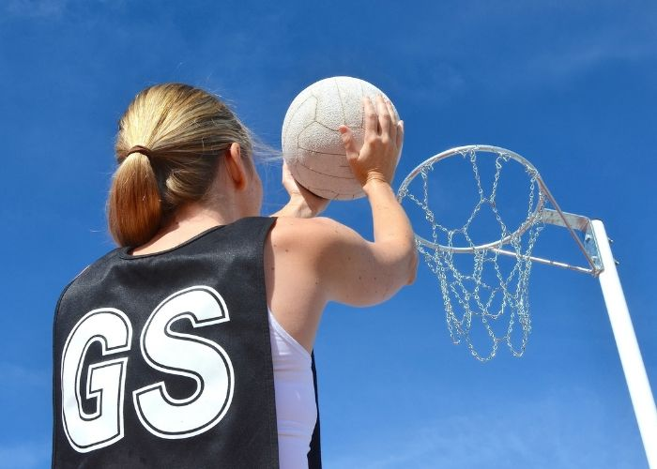
Y8 Netball: Journey of Knowledge (Tactics & Strategies)
The bigger picture:
Personal development opportunities – Leadership of others, listening and cooperation with others
Career links – Sports scientist, analyser, sports nutritionist
RSE – Physical, emotional and social well-being
Context and Introduction to Unit
In this unit pupils will learn about the skills and knowledge required to perform in netball effectively. They will continue to learn about the rules of the game and how to apply them to competitive situations demonstrating both control and accuracy. Pupils will learn specific skills including shooting, attacking and defending play, and also how to officiate in a game. Pupils will then be able to link the components of fitness to different aspects of netball. Pupils will also begin learn about tactics and strategies within the game.
Prior knowledge (KS2/KS3)
Pupils should build on the skills and knowledge already learned in Year 7
CORE KNOWLEDGE Physical Me Attacking – using a variety of passes with quality and accurate footwork Defending – marking the player with / without the ball, effective interceptions Shooting – from different angles around the semi circle, with a defender Width in play – utilizing the widths of the court to open up space CP routines – team planning the centre routines e.g. C-WA-GA-C-GS Thinking Me Y8 Focus: Tactics & Strategies Strategy: What are the most effective passes and when would you use them What is the most effective form of attack and defense in netball Effective shooting – how to get close to the post Tactics – opening up the space, using the width of the court, creating space Backline passes – most effective way to get ball into attacking third CP routines – most effective routine to get shot in goal third – to trick opposition How to referee (decision making, signals. Pupils should be able to support the progress of themselves and peers through the evaluation of strengths and weaknesses with the support of skill cards and teacher instruction. Oxygen is breathed in to the lungs and transfers into the blood stream via the alveoli. Healthy Me Pupils should demonstrate the appropriate levels of fitness for football as well as mental resilience to persist with the development of weaknesses. Pupils should recognize the wider health benefits of participation in football (Nutrition, positive body image, stress relief, preventing loneliness, new friendship, positive mindset). | Core Skills Lead others in warm up routines for netball (pulse raising activity such as jogging, shuttle runs, stretching muscles: hamstrings, quadriceps, gastrocnemius, triceps, biceps, deltoids). Demonstration and application of the following skills using the relevant shots from core knowledge: Attacking Defending Shooting Tactics : width in play and CP routines Umpiring Identify areas of strength and weakness in own performance. Articulate knowledge of tactics and strategies orally. Know why we cool down – to return body to normal state, remove lactic acid, return breathing/heart rate. Define key fitness components in relation to netball (Agility, power, coordination, balance, speed) and explain why they are important. | ABOVE AND BEYOND - Leadership of others (captain, coach, umpire) - Extra curricular involvement (school or community) - Compare skills/techniques of others (e.g. peers or elite performers) - How badminton affects health and fitness (e.g. weight management, improvement of fitness components) VOCABULARY Coordination – the use of two or more body parts at the same time Agility – changing direction at speed Speed – amount of time taken to cover a set distance Balance – keeping the centre of mass above the base of support Power – performing strength activities at speed | Literacy in PE ‘ABC’ – Agree with/Build on/Contradict This is our literacy focus in PE which is a form of ‘academic talk’. Pupils are asked to state why they either agree with something their peers have said, state how they can build upon this point, or how can they contradict what their peer has said to challenge the thought process. This can be related to performance, form, skill selection etc. WHERE NEXT? Evaluate and analyse performance making suggested improvements (Y9).
Anatomy & Physiology
Hamstrings Quadriceps Gastrocnemius Triceps Biceps Abdominals Deltoids Pectorals | Heart Lungs Arteries Veins Oxygen Deoxygenated Oxygenated

Slide 2
Year 8 Netball (Tactics & Strategies): Assessment Plan
MAPs – Pupils will complete one MAP mid way through this unit. Pupils will be assessed via:
Their practical ability demonstrated during the MAP lesson (passing, attacking, defending, shooting, width in play strategies, CP routines)
Their ability to apply and create relevant tactics and strategies to outwit opponents as well as to link to the relevant components of fitness for football. They can also describe the pathway of oxygen through the body.
Their ability to demonstrate their current levels of fitness, mental perseverance and social wellbeing by working collaboratively as a team.
Summative assessment (Me in PE) – The knowledge from this unit will be tested as part of a 1 hour P2S practical assessment at the end of the allocated half term focusing on Physical Me, Thinking Me and Healthy Me. Video evidence will be collected and the Me in PE assessment form will be completed by the class teacher.
Assessment Steps
Emerging | Developing | Securing | Mastering (up to ‘-’) | Excelling (Above and Beyond)
Pupils can demonstrate basic technique of the following skills with little to no tactical awareness using guidance from the teacher: Perform a very limited range of passes in attack in isolation with inconsistent accuracy and footwork Perform a limited range of defensive strategies which are ineffective Demonstrate shooting technique when in isolation but when under pressure lacks accuracy and control. Demonstrates limited awareness of how tactics and strategies can improve the game. Has a limited knowledge of umpiring using support from the teacher to enforce the rules. Can keep score. Can identify that blood transports oxygen around the body. Fitness is limited for Netball and is unable to sustain it for the duration of the activity (i.e. lacks coordination, agility, power and speed | Pupils can demonstrate fair technique of the following skills with some tactical awareness using guidance from the teacher: Can demonstrate some features of attacking play and footwork but inconsistent when under pressure Perform some defensive strategies with some effect (e.g. man to man marking) Demonstrate shooting technique when in isolation now showing some accuracy and control. Demonstrates some awareness of how tactics and strategies can improve the game. E.g. using the width in play Has a good knowledge of umpiring using some support from the teacher to enforce the rules. Can keep score and use some signals. Can describe the importance of a warm up/cool down and can lead one with support from peers/teacher referring to the relevant muscles and oxygen transportation around the body. Fitness is good for netball (i.e. coordination, agility, speed, power and balance). | Pupils must be able to perform the following activities with consistently good technique in isolation and under pressure: Can confidently perform a range of attacking features that are now becoming effective when under pressure. Can confidently demonstrate a range of defensive strategies that are more effective now when under pressure. Can confidently demonstrate a more consistent shooting technique from different areas of the semi circle with more accuracy and control Can effectively apply tactics and strategies to the game and demonstrate understanding e.g. use of CP routines -Has a very good knowledge of umpiring without support from the teacher to enforce the rules confidently. Can keep score and use signals whilst also explaining decisions made. Can explain the importance of a warm up/cool down and can lead an effective one. Can describe how blood is pumped around the body and why oxygen is needed in higher doses during exercise referring to blood vessels and relevant muscles for netball. Demonstrates an excellent level of fitness for netball referring to the components of fitness. | Pupils should be able to recall all the content in the knowledge journey and demonstrate application through the following in isolation and under pressure with accuracy: Can confidently and consistently perform all of the passes in netball and execute them with correct footwork in isolation and when under pressure. Can confidently demonstrate a range of defensive strategies consistently that are now extremely effective when under pressure. Can consistently shoot the ball from a wide range of distances with accuracy when under pressure from a defender. Can confidently execute effective tactics and strategies that contribute to the winning of the game. Has excellent knowledge of umpiring without support from the teacher to enforce the rules confidently. Can keep score and use hand signals confidently. Demonstrates an excellent level of fitness for netball identifying which areas could be improved on further. Explain the importance of a warm up/cool down to reduce the effects of muscle soreness referring to the order that blood travels to become oxygenated and used by the body. | Pupils should be able to recall and perform all the content in the knowledge journey as well demonstrate application whilst analysing others: Can confidently and consistently demonstrate all of the techniques within the scheme with precision, accuracy and fluidity at all times. Can confidently and consistently execute a wide range of defensive strategies when under pressure and also assist in developing others technique. Can shoot from all areas of the semi circle and can do so also on one foot when under pressure. Demonstrates excellent awareness of how tactics and strategies can be applied to the game and also confidently be Has excellent knowledge of umpiring without support from the teacher to enforce the rules confidently. Can keep score and use signals whilst also explaining decisions made with confidence. Fitness is excellent for netball and is able to sustain it for the duration of the activity at high levels of intensity (i.e. coordination, agility, speed, power and balance). Justify the importance of a warm up/cool down to reduce the effects of muscle soreness referring to the order that blood travels to become oxygenated and used by the body.

