Slide 1

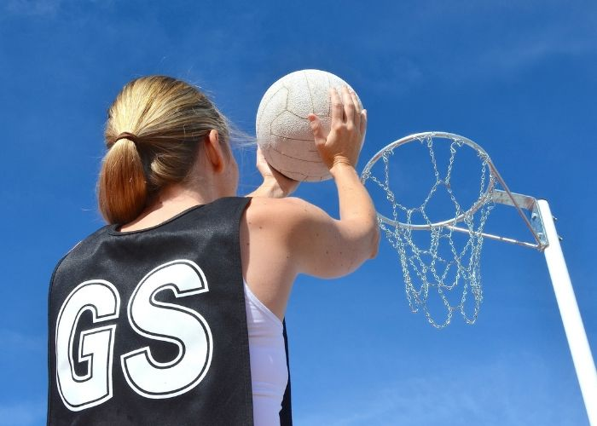
Y9 Netball: Journey of Knowledge (Analysis & Feedback)
The bigger picture:
Personal development opportunities – Self reflection, critique of others, problem solving, honest assessment, justification of opinions sensitively.
Career links – Sports scientist, Sports journalism.
RSE – Sports psychology linked to mental health. (Motivation, goal setting).
Context and Introduction to Unit
In this unit pupils will learn about the evaluation and analysis of performance in netball. They will learn how to observe other’s performance and highlight strengths and areas for improvement. They will also learn how to communicate their opinions effectively and sensitively. They will link the previous techniques learnt to their observations and be able to skilfully suggest ways in which improvement can be made; equally they will learn to evaluate the impact this has.
Prior knowledge (KS2/KS3)
In Y8 pupils will have learnt a range of tactics and strategies required to outwit opponents effectively in netball. They will have knowledge of the game rules and a range of skills including attacking, defending and shooting. They will also be able to plan tactics/strategies for success and also demonstrate adaptability to game play.
CORE KNOWLEDGE Physical Me – analyzing for strengths and weaknesses: Passing – for accuracy, when and how do you pass in different situations. Footwork – turning in the air, when and how to use this Shooting – for accuracy from a range of different places in the semi circle and with pressure of defenders. Tactics – when and how to use them effectively – CP routines Thinking Me Evaluation – identify strengths and weaknesses a peer/self performance. Analysis – observe and record events in performance, assess and monitor performance against criteria. Tactics – Use of tactics within game play to outwit opponents (CP routines, backline play, ways of attacking or defending). Umpiring – Accurately highlight any errors (footwork, obstruction, contact, direction of play). The Musculo-Skeletal System: Identify bones of the body and explain how muscles & bones work together to cause movement. Anatomy & Physiology – muscle action and how muscles work in antagonistic pairs. Through contraction and relaxation muscles create movement Healthy Me Pupils should demonstrate the appropriate levels of fitness for netball as well as mental stability in order to persist with areas of weakness and social health to work alongside others to perform and coach.. . Pupils should recognize the wider health benefits of participation in football (Nutrition, positive body image, stress relief, preventing loneliness, new friendship, positive mindset). | Core Skills - Lead others in warm up routines for football (pulse raising activity such as jogging, stretching muscles: hamstrings, quadriceps, gastrocnemius, triceps, biceps, deltoid, trapezius) Demonstration and application of the following skills: Observation (Looking for strengths and weaknesses). Analysis (Highlight areas of strength and weakness in performance). Feedback (Must be critical and indicate ways of which to improve). Communication (Articulate the strengths and weaknesses and apply with respect). Acting on advice from others (Listen to criticism and use this to improve). Justify areas of strength and weakness in own performance (Listen to peers assessment and watch back any video footage to develop technique when cross referencing this with elite models). -Articulate knowledge of tactics and strategies orally to others -Pupils must be able to explain how the tactics and strategies are effectively applied within the game. | ABOVE AND BEYOND - Critique the teachers technique whilst giving constructive feedback. - Critique a live game and provide constructive feedback to both players. VOCABULARY | Literacy in PE ‘ABC’ – Agree with/Build on/Contradict This is our literacy focus in PE which is a form of ‘academic talk’. Pupils are asked to state why they either agree with something their peers have said, state how they can build upon this point, or how can they contradict what their peer has said to challenge the thought process. This can be related to performance, form, skill selection etc. WHERE NEXT? Pupils demonstrate these skills in the ‘developing sports skills’ unit of Cambridge National: Sport Studies (Level 2)
Analysis & Feedback
Improvement Analysis Observing Critique Impact Criteria Review Peer Self Technique
Anatomy & Physiology
Heart Lungs Arteries Veins Oxygen Deoxygenated Oxygenated Ligaments Tendons Flexion Extension Cells | Hamstrings Quadriceps Gastrocnemius Triceps Biceps Abdominals Deltoids Pectorals Latissimus dorsi Femur Humerus Ribs

Slide 2
Year 9 Netball (Analysis & Feedback): Assessment Plan
MAPs – Pupils will complete one MAP mid way through this unit. Pupils will be assessed via:
1. Their practical ability demonstrated during the MAP lesson (Passing / footwork / marking technique depending on where they are up to in the scheme.)
2. Their ability to link the relevant components of fitness to the activity they are being assessed in.
3. Their ability to demonstrate their current levels of fitness, mental perseverance and social wellbeing by working collaboratively as a team.
Summative assessment (Me in PE) – The knowledge from this unit will be tested as part of a 1 hour P2S practical assessment at the end of the allocated half term focusing on Physical Me, Thinking Me and Healthy Me. Video evidence will be collected and the Me in PE assessment form will be completed by the class teacher.
Assessment Steps
Emerging | Developing | Securing | Mastering | Excelling
Pupils can demonstrate basic technique of passing/control, footwork and shooting skills. Analysis and feedback is limited and requires guidance from the teacher. Requires leadership from teacher/peers in identifying each stage of the relevant skill. Requires assistance when identifying weaknesses and communicating this to peers. Can play a small sided game but does not apply tactical elements to game play. Has a limited knowledge of umpiring using support from the teacher to enforce the rules. Can keep score. Can identify a few muscles accurately Cannot identify muscles that work in antagonistic pairs. Fitness is limited for netball and is unable to sustain it for the duration of the activity (i.e. lacks coordination, agility, power and speed). | Pupils can demonstrate fair technique of passing/control, footwork and shooting skills. Analysis and feedback is limited but requires some guidance from the teacher. -Can identify most strengths in performance but requires assistance when identifying weaknesses. Can provide feedback to peers unassisted but struggles to identify ways forward. Can play a small sided game and applies some tactical elements to game play. Has a good knowledge of umpiring using some support from the teacher to enforce the rules. Can keep score and use some signals. Can identify a few muscles accurately and relate to basic sporting movements. Can identify a pair of muscles that work in antagonistic pairs to create movement. Fitness is good for netball and is able to sustain it for the duration of the activity (i.e. coordination, agility, speed, power and balance). | Pupils must be able to perform all skills within the unit with consistently good technique and analysis and feedback is clear and precise. Can identify most strengths and weaknesses in performance whilst describing ways to improve. Can provide feedback to peers unassisted with at least two clear points made. Can play a small sided game and applies tactical elements to game play which are effective. Has a very good knowledge of umpiring without support from the teacher to enforce the rules confidently. Can keep score and use signals whilst also explaining decisions made. Can identify a range of muscles accurately and relate to basic sporting movements. Can identify muscles that work in antagonistic pairs to create movement and knows that muscles either contract or relax. Fitness is very good for netball and is able to sustain it for the duration of the activity (i.e. coordination, agility, speed, power and balance). | Pupils should be able to recall all the content in the knowledge journey and demonstrate clear and precise feedback through peer and self analysis Can identify all strengths and weaknesses in their own performance and others. Can provide clear and coherent feedback on their own performance and a partners by identifying clear ways forward and modelling correct technique. Can play a small sided game and applies tactical elements to game play which have a dominant impact on the game. Has excellent knowledge of umpiring without support from the teacher to enforce the rules confidently. Can keep score and use signals whilst also explaining decisions made with confidence. Can identify a wide range of muscles accurately and relate to more complex sporting movements. Can identify muscles that work in antagonistic pairs to create movement and knows that muscles either contract or relax. The contracting muscle shortens and fattens and the relaxing one lengthens. Fitness is excellent for netball and is able to sustain it for the duration of the activity at high levels of intensity (i.e. coordination, agility, speed, power and balance). | Pupils should be able to recall all the content in the knowledge journey and demonstrate excellent feedback through peer and self analysis. Can identify all strengths and weaknesses in their own performance and others, including game play and umpiring. Can provide clear and coherent feedback on their own performance and a partners by identifying clear ways forward and modelling correct technique, including refereeing. Has excellent knowledge of umpiring without support from the teacher to enforce the rules confidently. Can keep score and use signals whilst also explaining decisions made with confidence. Can identify all muscles (from GCSE PE) accurately and relate to complex sporting movements. Can identify muscles that work in antagonistic pairs to create movement and knows that muscles either contract or relax. The contracting muscle shortens and fattens and the relaxing one lengthens. Also knows about different types of muscle contraction (isotonic, isometric). Fitness is excellent for netball and is able to sustain it for the duration of the activity at high levels of intensity (i.e. coordination, agility, speed, power and balance).

