Slide 1
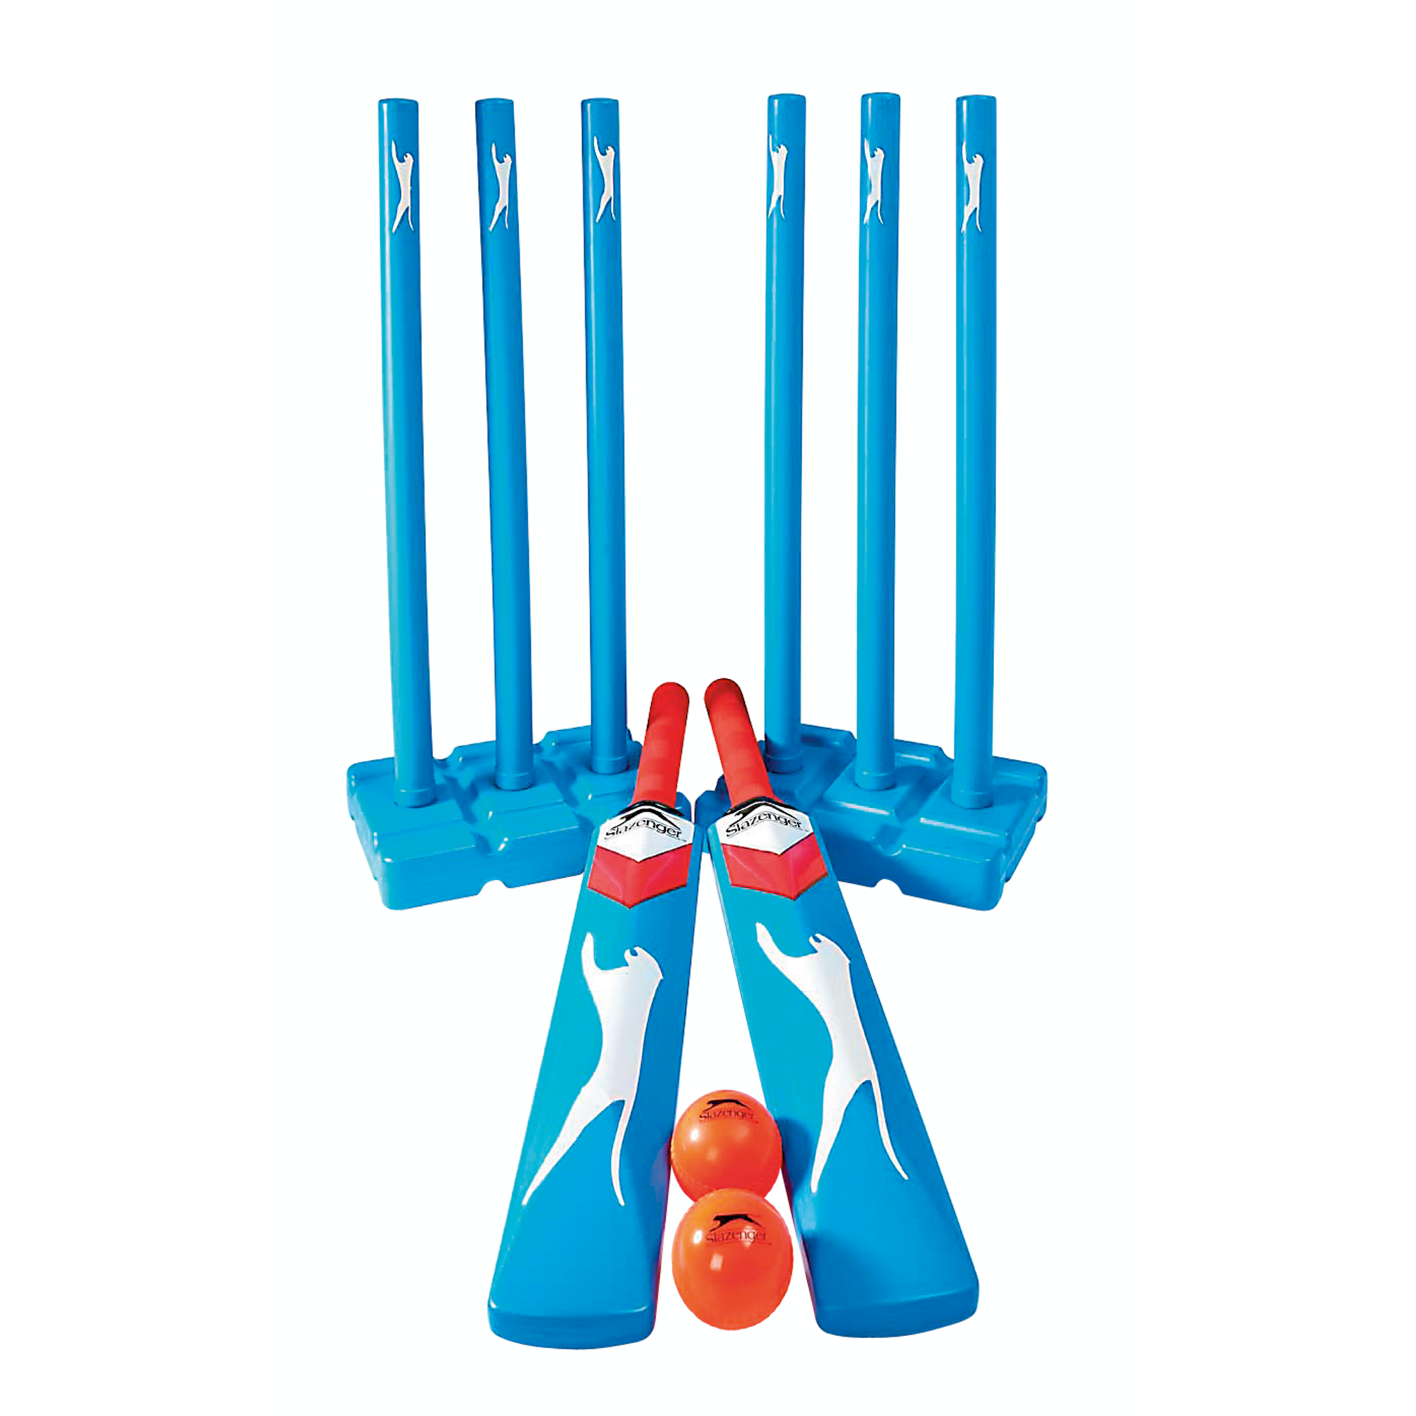
Y8 Striking & Fielding (Tactics and Strategies): Journey of Knowledge
The bigger picture:
Personal development opportunities – Social skills including team work, organisation and planning.
Career links – PE teacher, physiotherapist, sports journalist, outdoor education instructor, coach, professional athlete, personal trainer.
RSE – ethics, compassion.
Context and Introduction to Unit
In this unit pupils will learn about tactics and strategies required to outwit opponents effectively in striking and fielding sports (cricket, rounders, softball) – Bowling to outwit, batting to outwit, fielding placement, communication & ball retrieval. They will learn about more complex rules of game play and be able to apply and link them to competitive situations demonstrating greater knowledge and understanding of the game. Pupils will learn to use their skills showing disguise, placement and adaptability to varying situations and be able to plan tactics/strategies for success with others in their team. They will be able to link these from previous units and similar sports.
Prior knowledge (KS2/KS3)
In Y7 pupils will have learnt the basic skills for cricket, rounders and softball such as bowling, batting and throwing/catching. They will have a basic understanding of game rules and have practiced them in competitive situations.
CORE KNOWLEDGE Physical Me Disguise – fake a movement and then perform something different (i.e.. Pretend to bat left, but then bat right) Placement – plan where you want the ball to go (encourage shots where there are no fielders) Positioning – positioning of players in your team (consider positions in the field) Thinking Me Cricket rules 1 bounce from a bowl Bowl must be within range of batter Batter must stay in crease Run between bases to score – boundaries 4 or 6 Rounders/softball rules Under arm bowl – 1 clean bowl (must run) No run when hit behind No overtaking Stump base before runner to get them out Catch or run out Tactics & Strategies: Outwitting and opponent when bowling (Fast/spin), opting for defensive/offensive batting depending on the incoming bowl, selecting the right fielder to throw to when fielding and using the long barrier effectively. ABC: Pupils are asked relevant questions about their lesson focus by the teacher (teaching points/tactics) and other pupils are asked to A, B or C their responses. Cardiovascular System: The role of the heart and lungs in supplying the body with oxygen and removing waste products. Including the blood vessels (arteries, veins and capillaries). Healthy Me Physical health in order to meet the requirements of S&F– Coordination, cardiovascular endurance, agility, balance, speed, power, reaction time. Social Me This takes into account the behaviour/attitude of pupils as well as their ability to support each other and work together as a team. Also when explaining tactics and strategies to one another. Resilient Me Doesn’t give up when skills are challenging and regroups and evaluates well when skills are not working successfully. | CORE SKILLS Lead others in warm up routines for cricket, rounders or softball (pulse raising activity such as jogging, stretching muscles: hamstrings, quadriceps, gastrocnemius, triceps, biceps, deltoid, trapezius) Demonstration and application of the following skills; Bowling to outwit the batter Batting and disguise Catching and field placement Throwing from distance Ball retrieval Officiating Identify areas of strength and weakness in own performance Articulate knowledge of tactics and strategies orally – Use of ABC in order to critique/agree with peers decisions. Health/Fitness Know why we cool down – to return body to normal state, remove lactic acid, return breathing/heart rate Recall key fitness components in relation to cricket, rounders, softball (Agility, power, coordination) and why they are important for the sports | ABOVE AND BEYOND Leadership of others (captain, coach, umpire) Extra curricular involvement (school or community) Compare skills/techniques of others (e.g. peers or elite performers) How cricket, softball, rounders affects health and fitness (e.g. weight management, improvement of fitness components) VOCABULARY | Literacy in PE ‘ABC’ – Agree with/Build on/Contradict This is our literacy focus in PE which is a form of ‘academic talk’. Pupils are asked to state why they either agree with something their peers have said, state how they can build upon this point, or how can they contradict what their peer has said to challenge the thought process. This can be related to performance, form, skill selection etc. WHERE NEXT? Evaluate and analyse performance making suggested improvements (Y9)
Components of Fitness
Agility – Changing direction at speed Coordination – Use two or more body parts at the same time Power – Using strength quickly Speed – The time it takes to cover a distance Reaction Time – The time it takes to react to a stimulus
Word-rich Focus – Summer Term: Cardiovascular System
Heart Oxygenated Blood Deoxygenated bllod Oxygen | Red blood cells Veins Arteries Capillaries

Slide 2
Year 8 Striking & Fielding: Assessment Plan
MAPs – Pupils will be assessed at the end of each topic via the Me in PE assessment model:
Physical Me: Skills and application of these into a competitive situation.
Thinking Me: ABC/CV System/Tactics & strategies
Healthy Me: Physical attributes that are relevant to the activity.
Social Me: Behaviour, attitudes and support towards other pupils.
Resilient Me: Never giving up despite the challenge of the task that is presented to pupils.
Summative assessment (Me in PE) – The knowledge from this unit will be tested as part of a 1 hour P2S practical assessment at the end of the allocated half term focusing on Physical Me, Thinking Me, Healthy Me, Social Me and Resilient Me. The Me in PE assessment will be completed by the class teacher and distributed to pupils once the marks have been finalised so pupils can be informed which of the 5 areas they are performing well in and which areas they need to work further on.
Assessment Steps
Emerging | Developing | Securing | Mastering (Up to ‘-’)
Pupils can demonstrate basic technique of the following skills with little to no tactical awareness using guidance from the teacher: Demonstrates some bowling skills (varying line and length). Unable to use spin to outwit the batter. Demonstrates some batting and disguise in isolation and under pressure but lacks accuracy and fluency in technique. Demonstrates some throwing and footwork to outwit/beat the batter in isolation and under pressure but lacks accuracy and power. Demonstrates catching in isolation and under pressure but lacks accuracy and coordination. Can play a small sided game but does not apply tactical elements to game play. Demonstrates some awareness positioning but is unable to sustain a role. Unable to consider which position is more effective tactically. Has a limited knowledge of umpiring using support from the teacher to enforce the rules. Can keep score. Demonstrates limited awareness of rounders/cricket/softball rules. Very limited knowledge of CV system. Very limited speed, power, agility, reaction time and coordination. Social skills are very limited as well as communication between peers. Unwilling to persist with difficult challenges. | Pupils can demonstrate fair technique of the following skills with some tactical awareness using guidance from the teacher: Demonstrates bowling skills (varying line and length) with some accuracy and fluency in technique. Able to use spin sometimes to outwit the batter but not always accurate. Demonstrates batting and disguise (e.g. reverse hit, defensive shot) with some accuracy and consistency in technique. Demonstrates throwing and footwork to outwit/beat the batter with some accuracy and power. Demonstrates catching with some accuracy and coordination (with both hands and sometimes with one hand). Demonstrate some more advanced tactics (fielders walking in, throwing to certain bases/points to get the batter out) but these are not consistent. Can play a small sided game and applies some tactical elements to game play. Demonstrates good awareness of different positions but is inconsistent in sustaining a role. Has a good knowledge of umpiring using some support from the teacher to enforce the rules. Can keep score and use some signals. Demonstrates good awareness of rounders/cricket/softball rules. Limited knowledge of CV system. Limited speed, power, agility, reaction time and coordination. Social skills are inconsistent as well as communication between peers which can sometimes be limited. Gives up occasionally when faced with difficult challenges. | Pupils must be able to perform the following activities with consistently good technique in isolation and under pressure: Demonstrates bowling skills (varying line and length) Able to use spin to outwit the batter with accuracy and success. Demonstrates good batting and disguise (e.g. reverse hit, defensive shot) with accuracy and consistency in technique. Can hit into space. Demonstrates good throwing and footwork to outwit/beat the batter with accuracy and enough power to reach the target. Demonstrates catching with some accuracy and coordination (with both hands and sometimes with one hand) from static or moving positions. Demonstrate some more advanced tactics (fielders walking in, throwing to certain bases/points to get the batter out) which have some effect on game play. Demonstrates very good awareness of different positions and can explain when you might use these systems. Has a very good knowledge of umpiring without support from the teacher to enforce the rules confidently. Can keep score and use signals whilst also explaining decisions made. Demonstrates very good awareness of rounders/cricket/softball rules (e.g. wide’s, no balls, rule violations) and decision making is mostly accurate. Fitness is very good for rounders/cricket/softball and is able to sustain it for the duration of the activity. Good knowledge of CV system linking it to performance in athletics and the various events. Secure levels of speed, power, agility, reaction time and coordination. Displays confidence in their social skills with good communication between their peers that often requires little to no support from the teacher. Rarely gives up when faced with a difficult challenge and persists with the task at hand. | Pupils should be able to recall all the content in the knowledge journey and demonstrate application through the following in isolation and under pressure with accuracy: Confidently demonstrates bowling using different techniques (under, over, spin, seam). Able to use techniques in order to outwit the batter. Confidently demonstrates batting and disguise with placement of shots. Confidently demonstrates throwing and footwork to outwit/beat the batter. This is performed using disguise within movements. Confidently demonstrates coordination in catching (with both hands and with one hand) from static or moving positions. Can catch from varying heights, distances and speeds. Demonstrate more advanced tactics (fielders walking in, throwing to certain bases/points to get the batter out) which have a big impact. Can play a small sided game and applies tactical elements to game play which have a dominant impact on the game. Demonstrates excellent awareness of different position and can explain when you might use these and for what benefit. Can sustain a given role in the game and evaluate the effectiveness of any tactics adopted. Has excellent knowledge of umpiring without support from the teacher to enforce the rules confidently. Can keep score and use hand signals confidently. Demonstrates excellent awareness of rounders/cricket/softball rules (e.g. wide’s, no balls, rule violations) and decision making is almost always accurate. Fitness is excellent for rounders/cricket/softball and is able to sustain it for the duration of the activity at high levels of intensity. Excellent knowledge of the CV system and the effects athletics can have on this. Elite levels of speed, power, agility, reaction time and coordination. Displays confidence in their social skills and can lead small groups during drills. Never gives up when faced with a difficult challenge and enjoys these circumstances.

