Slide 1
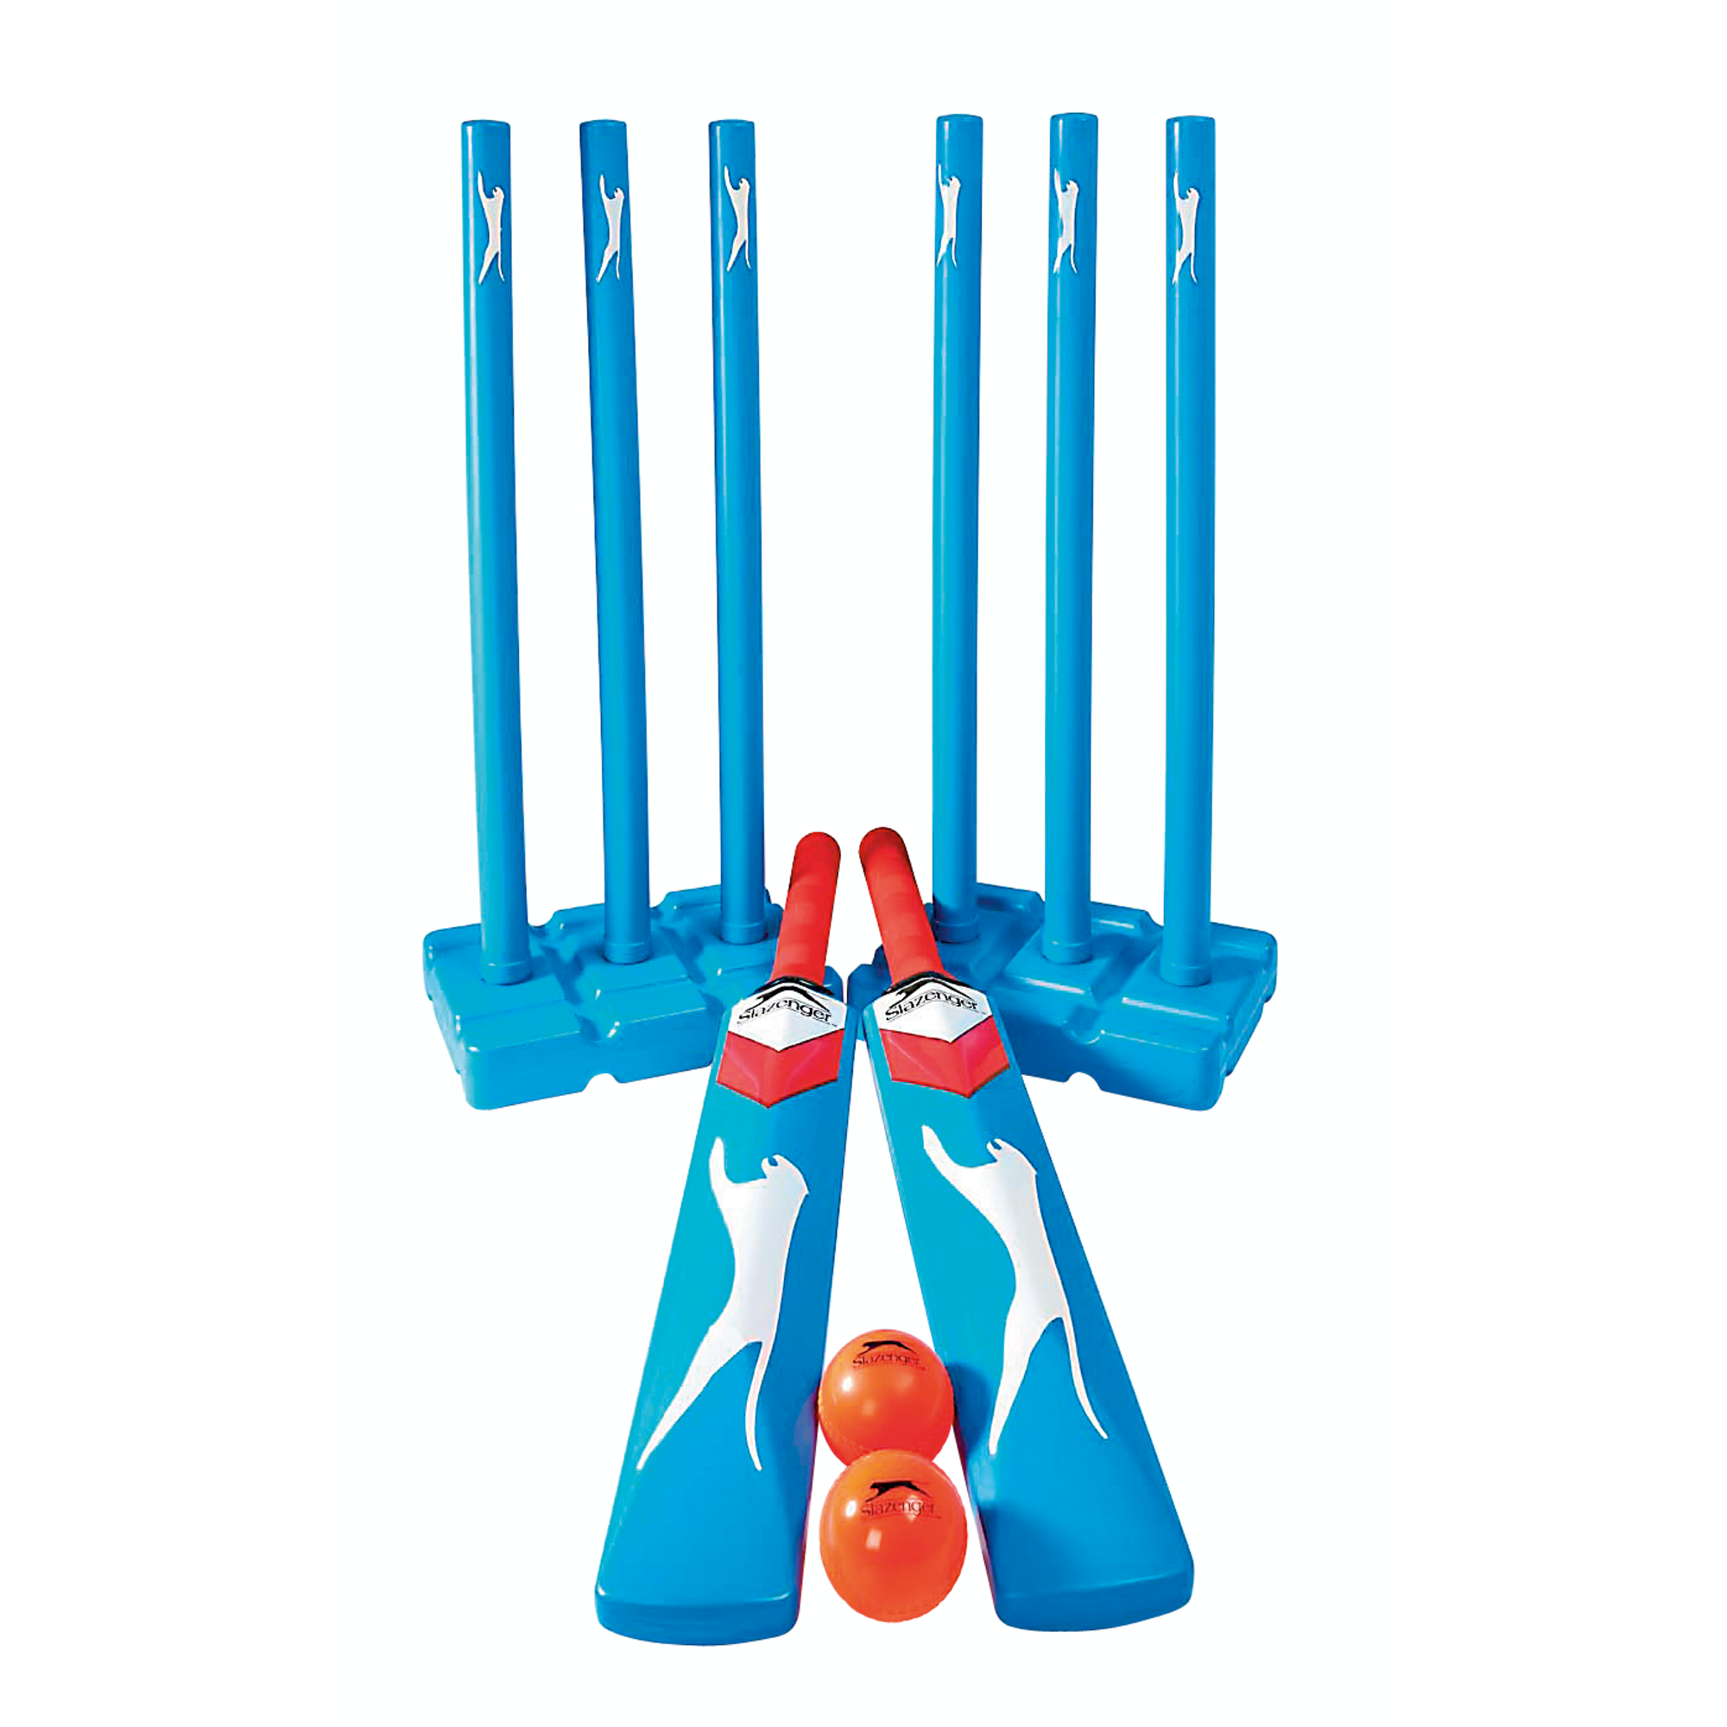
Y9 Striking & Fielding (Evaluation and Analysis): Journey of Knowledge
The bigger picture:
Personal development opportunities – Social skills including team work, organisation and planning.
Career links – PE teacher, physiotherapist, sports journalist, outdoor education instructor, coach, professional athlete, personal trainer
RSE – ethics, compassion.
Context and Introduction to Unit
In this unit pupils will learn about the evaluation and analysis of performance in striking and fielding sports (cricket, rounders, softball) – Batting, bowling, fielding. They will learn how to observe other’s performance and highlight strengths and areas for improvement. They will also learn how to communicate their opinions effectively and sensitively. They will link the previous techniques learnt to their observations and be able to skilfully suggest ways in which improvement can be made; equally they will learn to evaluate the impact this has.
Prior knowledge (Year 8)
In Y8 pupils will have learnt a range of tactics and strategies required to outwit opponents effectively in cricket, rounders and softball. The will have knowledge of the game rules and a range of skills including bowling, batting and throwing/catching. They will also be able to plan tactics/strategies for success and also demonstrate disguise, placement and adaptability to game play.
CORE KNOWLEDGE Physical Me Batting Analysis – stand sideways looking at bowler, start with the bat back, weight on back foot, swing forward as the ball bounces. Rounders Bowling Analysis – step in to the bowl, swing arm forward, follow through pointing at target. Cricket bowling Analysis – stand sideways, grip ball with thumb and 2 fingers, keep arm straight as circle past head (Backwards 6) – Windmill technique. Throwing Analysis – ball above head, step with opposite foot to hand, wave arm back first and then thrust forward and release. Catching Analysis – get hands ready early, watch the ball into cupped hands, move hands towards body as ball enters hands. Thinking Me Analysis & Feedback – identify strengths and weaknesses a peer/self performance. Observe and record events in performance, assess and monitor performance against criteria such as normative data/skill cards. ABC: Pupils are asked relevant questions about their lesson focus by the teacher (teaching points/tactics) and other pupils are asked to A, B or C their responses. Long-term effects of exercise: Hypertrophy, cardiac output, heart rate, stroke volume and vital capacity. Healthy Me Physical health in order to meet the requirements of athletics – Coordination, cardiovascular endurance, agility, balance, speed power, reaction time. Social Me This takes into account the behaviour/attitude of pupils as well as their ability to support each other and work together as a team. Also when analysing skills/tactics to each other in order to outperform another opponent in any striking and fielding environment. Resilient Me Doesn’t give up when skills are challenging and regroups and evaluates well when analysis is not as effective as it could be. | CORE SKILLS Lead others in warm up routines for cricket, rounders or softball (pulse raising activity such as jogging, stretching muscles: hamstrings, quadriceps, gastrocnemius, triceps, biceps, deltoid, trapezius) Demonstration and application of the following skills; Observation Assessment Recording accurately Measurement Review Communication Acting on advice from others Justify areas of strength and weakness in own performance (Listen to peers assessment and watch back any video footage to develop technique when cross referencing this with elite models). Articulate knowledge of tactics and strategies orally to others as well as coach a partner/team upon analysis of live play. | ABOVE AND BEYOND Coach others whilst linking weaknesses to components of fitness as well as angles of release. Model correct technique (demonstration/explanation). Explain the relevant sporting injuries linked to striking and fielding activities. VOCABULARY | Literacy in PE ‘ABC’ – Agree with/Build on/Contradict This is our literacy focus in PE which is a form of ‘academic talk’. Pupils are asked to state why they either agree with something their peers have said, state how they can build upon this point, or how can they contradict what their peer has said to challenge the thought process. This can be related to performance, form, skill selection etc. WHERE NEXT? Pupils demonstrate these skills in the ‘developing sports skills’ unit of Cambridge National: Sport Studies (Level 2)
Components of Fitness
Agility – How quickly you can change direction. Coordination – The ability to use more than one body part at the same time. Speed – The time taken to cover a distance. Power – Using speed quickly (Strength x speed). Reaction Time – The time it takes to respond to a stimulus.
Word-rich Focus: Summer Term 1 & 2 Long-term Effects of Exercise
Hypertrophy – An increase in size and strength of muscle tissue from exercise. Cardiac Output – Amount of blood pumped out the heart in one minute increases. | Heart rate – The amount of blood that leaves the heart in one beat decreases. Stroke volume – The amount of blood that pumps out the heart with every beat increases.

Slide 2
Year 9 Striking & Fielding: Assessment Plan
MAPs – Pupils will be assessed at the end of each topic via the Me in PE assessment model:
Physical Me: Skills and application of these into a competitive situation.
Thinking Me: ABC/Long-term effects of exercise on the cardio-respiratory system.
Healthy Me: Physical attributes that are relevant to the activity.
Social Me: Behaviour, attitudes and support towards other pupils.
Resilient Me: Never giving up despite the challenge of the task that is presented to pupils.
Summative assessment (Me in PE) – The knowledge from this unit will be tested as part of a 1 hour P2S practical assessment at the end of the allocated half term focusing on Physical Me, Thinking Me, Healthy Me, Social Me and Resilient Me. The Me in PE assessment will be completed by the class teacher and distributed to pupils once the marks have been finalised so pupils can be informed which of the 5 areas they are performing well in and which areas they need to work further on.
Assessment Steps
Emerging | Developing | Securing | Mastering | Excelling (Above and Beyond)
Pupils can demonstrate basic technique of bowling, batting, throwing and catching skills. Analysis and feedback is limited and requires guidance from the teacher. Requires leadership from teacher/peers in identifying each stage of the relevant skill. Requires assistance when identifying weaknesses and communicating this to peers. Can play a small sided game but does not apply tactical elements to game play. Has a limited knowledge of umpiring using support from the teacher to enforce the rules. Can keep score. Very limited knowledge of the long-term effects of exercise on the C-R system. Very limited speed, power, agility, reaction time and coordination. Social skills are very limited as well as communication between peers when providing feedback. Unwilling to persist with difficult challenges. | Pupils can demonstrate fair technique of bowling, batting, throwing and catching skills. Analysis and feedback is limited but requires some guidance from the teacher. Can identify most strengths in performance but requires assistance when identifying weaknesses. Can provide feedback to peers unassisted but struggles to identify ways forward. Can play a small sided game and applies some tactical elements to game play. Has a good knowledge of umpiring using some support from the teacher to enforce the rules. Can keep score and use some signals. Limited knowledge of the long-term effects of exercise on the C-R system. Limited speed, power, agility, reaction time and coordination. Social skills are limited as well as communication between peers when providing feedback. Sometimes persists with difficult challenges. | Pupils must be able to perform all skills within the unit with consistently good technique and analysis and feedback is clear and precise. Can identify most strengths and weaknesses in performance whilst describing ways to improve. Can provide feedback to peers unassisted with at least two clear points made. Can play a small sided game and applies tactical elements to game play which are effective. Has a very good knowledge of umpiring without support from the teacher to enforce the rules confidently. Can keep score and use signals whilst also explaining decisions made. Good knowledge of the long-term effects of exercise on the C-R system. Good levels of speed, power, agility, reaction time and coordination. Social skills are developed as well as communication between peers when providing feedback. Usually persists with difficult challenges. | Pupils should be able to recall all the content in the knowledge journey and demonstrate clear and precise feedback through peer and self analysis. Can identify all strengths and weaknesses in their own performance and others. Can provide clear and coherent feedback on their own performance and a partners by identifying clear ways forward and modelling correct technique. Can play a small sided game and applies tactical elements to game play which have a dominant impact on the game. Has excellent knowledge of umpiring without support from the teacher to enforce the rules confidently. Can keep score and use signals whilst also explaining decisions made with confidence. Excellent knowledge of the long-term effects of exercise on the C-R system. Excellent levels of speed, power, agility, reaction time and coordination. Social skills are very good as well as communication between peers when providing feedback. Always persists with difficult challenges. | Pupils should be able to recall all the content in the knowledge journey and demonstrate excellent feedback through peer and self analysis. Can identify all strengths and weaknesses in their own performance and others, including game play and umpiring. Can provide clear and coherent feedback on their own performance and a partners by identifying clear ways forward and modelling correct technique, including umpiring. Has excellent knowledge of umpiring without support from the teacher to enforce the rules confidently. Can keep score and use signals whilst also explaining decisions made with confidence. Excellent knowledge of the long-term effects of exercise on the C-R system and can inform others of this during analysis and feedback. Elite levels of speed, power, agility, reaction time and coordination. Social skills are excellent as well as communication between peers when providing feedback (Coaching). Always persists with difficult challenges and seeks new ones.

