Slide 1
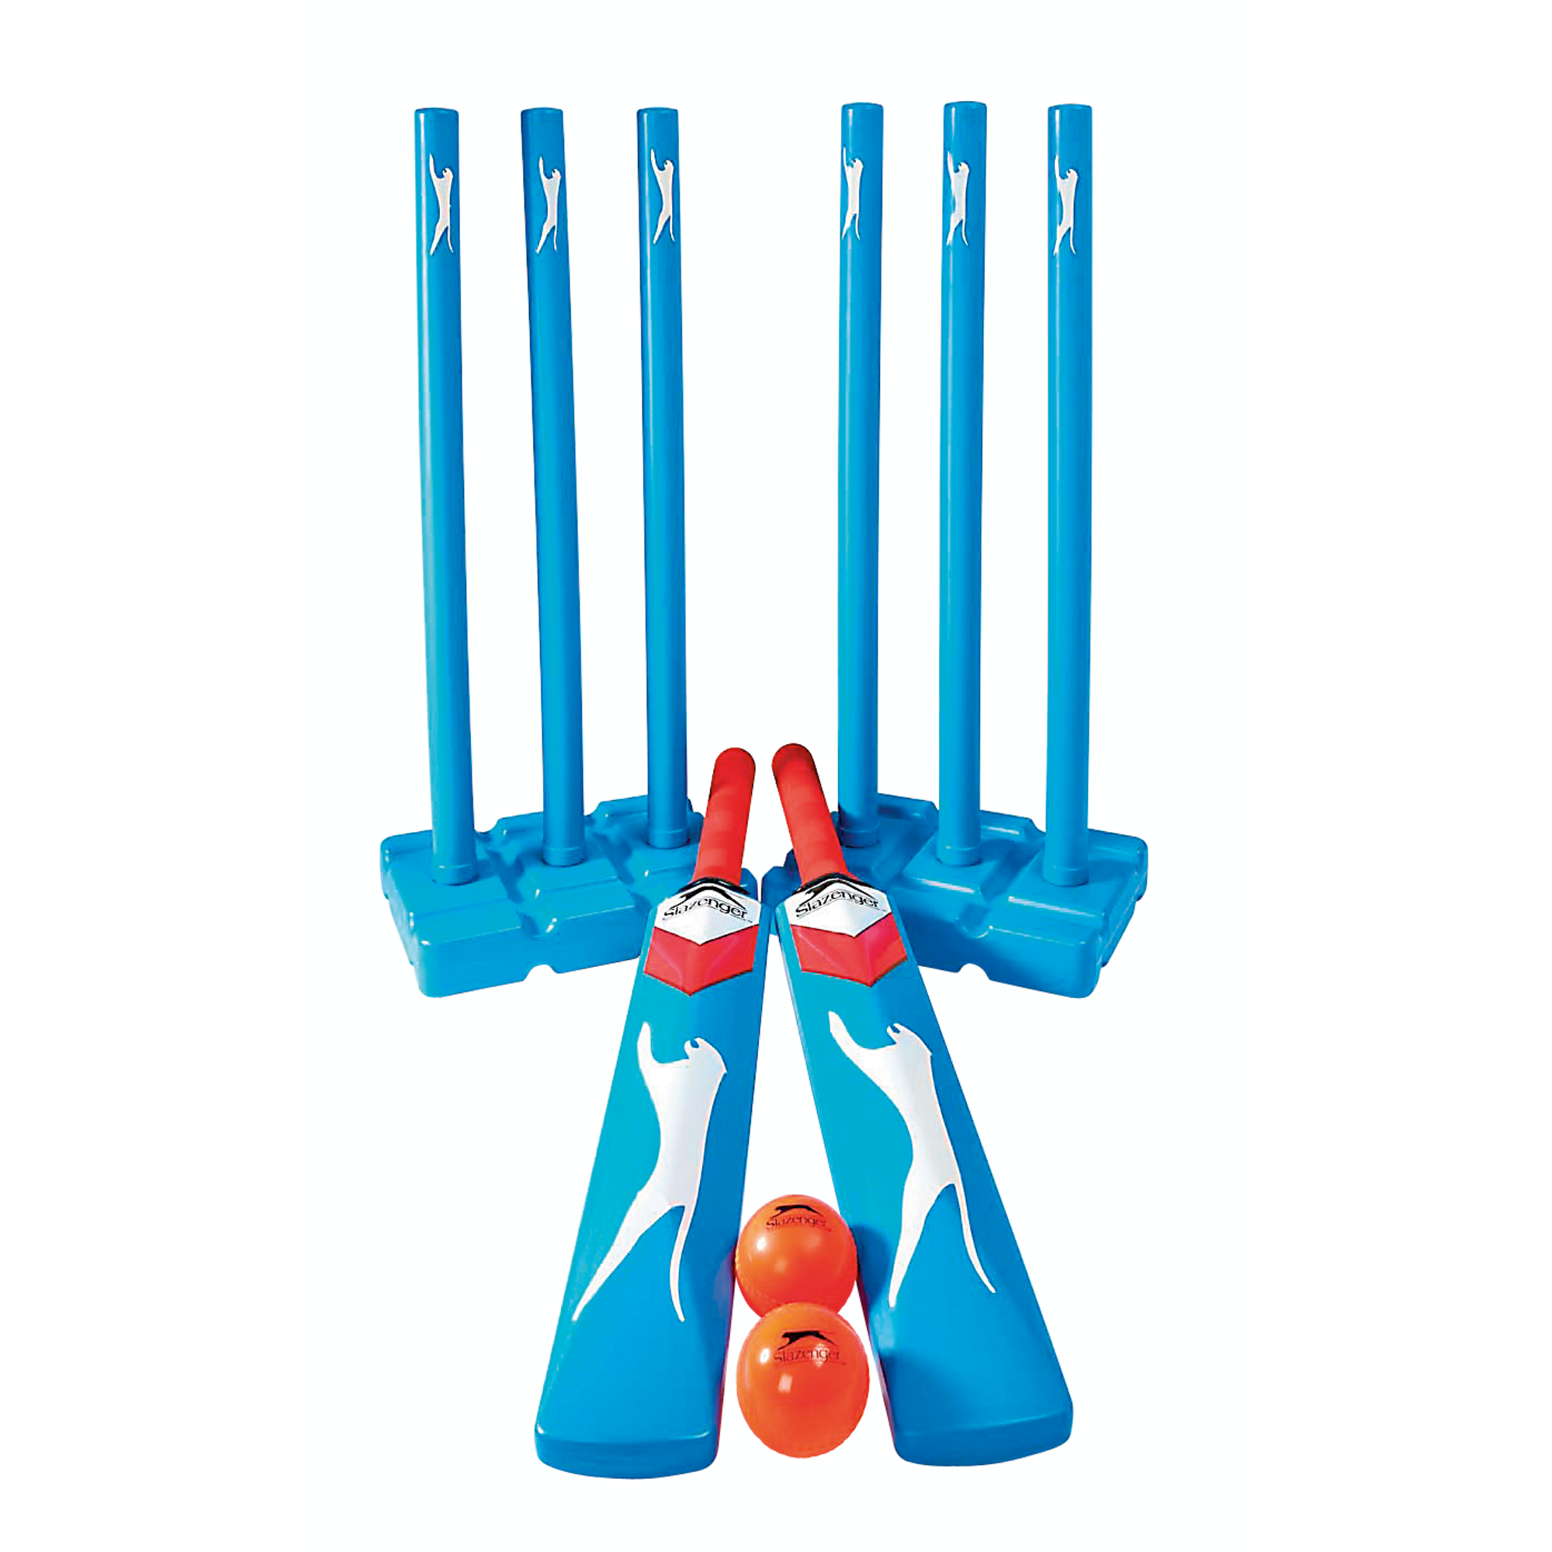
Y7 Striking & Fielding (Skill Development): Journey of Knowledge
The bigger picture:
Personal development opportunities – Social skills including team work, organisation and planning.
Career links – PE teacher, physiotherapist, sports journalist, outdoor education instructor, coach, professional athlete, personal trainer.
RSE – ethics, compassion.
Context and Introduction to Unit
In this unit pupils will learn about the skills and abilities required to perform in striking and fielding sports (cricket/rounders) effectively. They will learn about the rules of game play and be able to apply and link them to competitive situations demonstrating both control and accuracy. Pupils will learn specific skills including, bowling, batting, throwing and catching, and ball retrieval as well as officiating. They will learn to use these skills to outwit opponents in challenging game based environments and will be able to link skills from previous units and similar sports.
Prior knowledge (KS2/KS3)
Pupils should be able to play competitive games, modified where appropriate and apply basic principles suitable for striking and fielding sports. This includes basic throwing and catching principles and awareness of space and movement. They may also have prior knowledge of basic rules for Kwik cricket and rounders.
CORE KNOWLEDGE ‘Physical Me’ Batting – stand sideways looking at bowler, start with the bat back, weight on back foot, swing forward as the ball bounces Rounders Bowling – step into the bowl, swing arm forward, follow through pointing at target. Cricket bowling – stand sideways, grip ball with thumb and 2 fingers, keep arm straight as circle past head Throwing – ball above head, step with opposite foot to hand, wave arm back first and then thrust forward and release Catching – get hands ready early, watch the ball into cupped hands, move hands towards body as ball enters hands ‘Thinking Me’ Cricket rules 1 bounce from a bowl Bowl must be within range of batter Batter must stay in crease Run between bases to score – boundaries 4 or 6 Rounders/softball rules Under arm bowl – 1 clean bowl (must run) No run when hit behind No overtaking Stump base before runner to get them out Catch or run out ABC: Pupils are asked relevant questions about their lesson focus by the teacher (teaching points/tactics) and other pupils are asked to A, B or C their responses. Bones: The main bones of the body that are relevant to the movement in sporting activity such as athletics (See bones box in the vocabulary section). Necessary information to include – Whether the relevant bone is long/short/flat/irregular, as well as the main muscles that are attached to the bone. Healthy Me Physical health in order to meet the requirements of S&F– Coordination, cardiovascular endurance, agility, balance, speed, power, reaction time. Social Me This takes into account the behaviour/attitude of pupils as well as their ability to support each other and work together as a team. Also when explaining teaching points to each other to assist in each others development. Resilient Me - Doesn’t give up when skills are challenging and regroups and evaluates well when skills are not working successfully | CORE SKILLS Demonstrate warm up routines for cricket, rounders, softball (pulse raising activity such as jogging, stretching muscles: hamstrings, quadriceps, gastrocnemius, triceps, biceps) Demonstration and application of the following skills; Batting Bowling Throwing Catching Retrieval and blocking Identify areas of strength and weakness in a peers performance (Assessment) Articulate knowledge of skills technique orally Health/Fitness Know why we warm up - to prevent injury, mobilise joints, raise body temperature Recall key fitness components in relation to cricket/rounders/softball (balance, coordination, reaction time) | ABOVE AND BEYOND Leadership of others (captain, coach, manager) Extra curricular involvement (school or community) VOCABULARY | Literacy in PE ‘ABC’ – Agree with/Build on/Contradict This is our literacy focus in PE which is a form of ‘academic talk’. Pupils are asked to state why they either agree with something their peers have said, state how they can build upon this point, or how can they contradict what their peer has said to challenge the thought process. This can be related to performance, form, skill selection etc. WHERE NEXT? Tactics and strategies for cricket, rounders and softball (Y8)
Components of Fitness
Coordination – The use of two or more body parts at the same time. Balance – Keeping the centre of mass over the base of support. Reaction Time – The time is takes to respond to a stimulus. Agility – The ability to change direction quickly. Speed – The time it takes to cover a distance.
Word-rich Focus - Summer Term: Bones
Humerus Femur Ribs | Sternum Vertebrae Cranium

Slide 2
Year 7 Striking & Fielding: Assessment Plan
MAPs – Pupils will be assessed at the end of each topic via the Me in PE assessment model:
Physical Me: Skills and application of these into a competitive situation.
Thinking Me: ABC/Bones
Healthy Me: Physical attributes that are relevant to the activity.
Social Me: Behaviour, attitudes and support towards other pupils.
Resilient Me: Never giving up despite the challenge of the task that is presented to pupils.
Summative assessment (Me in PE) – The knowledge from this unit will be tested as part of a 1 hour P2S practical assessment at the end of the allocated half term focusing on Physical Me, Thinking Me, Healthy Me, Social Me and Resilient Me. The Me in PE assessment will be completed by the class teacher and distributed to pupils once the marks have been finalised so pupils can be informed which of the 5 areas they are performing well in and which areas they need to work further on.
Assessment Steps
Emerging | Developing | Securing (Up to ‘+’) | Mastering (Above and Beyond)
Pupils have basic knowledge of game rules as well how to perform bowling, batting, throwing and catching skills, as well as the ability to umpire effectively; they require lots of support from their teacher; limited knowledge of teaching points; coordination and speed is very limited; requires a lot of support when communicating ideas; rarely persists with difficult challenges: Able to bowl/bat/throw/catch with very limited levels of coordination and agility in cricket/rounders. Requires lots of support when umpiring or identifying various positions on cricket/rounders teams. Articulation is very limited when explaining teaching points and how they are applied into a competitive situation. Very limited knowledge of bones in the body. Very limited speed, power, agility, reaction time and coordination. Social skills are very limited as well as communication between peers when fielding or coaching. Unwilling to persist with difficult challenges. | Pupils have a basic knowledge of game rules as well how to perform bowling, batting, throwing and catching skills, although performance can be inconsistent. They can umpire effectively but require help from their teacher: decent knowledge of teaching points; coordination and speed is inconsistent; requires some support when communicating ideas; occasionally persists with difficult challenges: Able to bowl/bat/throw/catch with limited levels of coordination and agility in cricket/rounders. Requires some support when umpiring or identifying various positions on cricket/rounders teams. Articulation is limited when explaining teaching points and how they are applied into a competitive situation. Sometimes uses relevant terminology and tier 3 words. Limited knowledge of bones in the body. Limited speed, power, agility, reaction time and coordination. Social skills are inconsistent as well as communication between peers which can sometimes be limited when fielding or coaching. Gives up occasionally when faced with difficult challenges. | Pupils have good knowledge of game rules as well how to perform bowling, batting, throwing and catching skills with consistent performance. They can umpire effectively with little help from their teacher: good knowledge of teaching points; coordination and speed is good; requires little support when communicating ideas; usually persists with difficult challenges: Able to bowl/bat/throw/catch with good levels of coordination and agility in cricket/rounders. Requires little to no support when umpiring or identifying various positions on cricket/rounders teams. Articulation of performance is good. Pupils are able to link the relevant terminology and tier 3 words into sentences without much support from the teacher/peers. Good knowledge of the bones of the body. Secure levels of speed, power, agility, reaction time and coordination. Displays confidence in their social skills with good communication between their peers that often requires little to no support from the teacher when fielding or coaching. Rarely gives up when faced with a difficult challenge and persists with the task at hand. | Pupils have excellent knowledge of game rules as well how to perform bowling, batting, throwing and catching skills with consistent performance. They can umpire effectively on an independent basis: excellent knowledge of teaching points; coordination and speed is excellent; requires no support when communicating ideas; always persists with difficult challenges: Able to bowl/bat/throw/catch with excellent levels of coordination and agility in cricket/rounders. Requires no support when umpiring or identifying various positions on cricket/rounders teams. Articulation of performance is clear, concise and developed. Pupils are able to link the relevant terminology and tier 3 words into sentences unsupported. Excellent knowledge of the bones of the body. Elite levels of speed, power, agility, reaction time and coordination. Displays confidence in their social skills and can lead small groups during drills and can dictate/allocate positions on a cricket/rounders team amongst their group. Never gives up when faced with a difficult challenge and enjoys these circumstances.

